Slide 1
BIL | TAJUK | TARIKH | SURATKHABAR
1 | PELUANG MALAYSIA PERKASA SEKTOR E & E | 13 MAC 2024 | SINAR HARIAN
2 | UNLOCK A BRIGHTER FUTURE AND EMPOWER YOUR SUSTAINABLE JOURNEY | 20 MAC2024 | NEW STRAITS TIMES
3 | SAIC PERKENAL EV BERMULA RM103,999 | 28 MAC 2024 | BERITA HARIAN

Slide 2
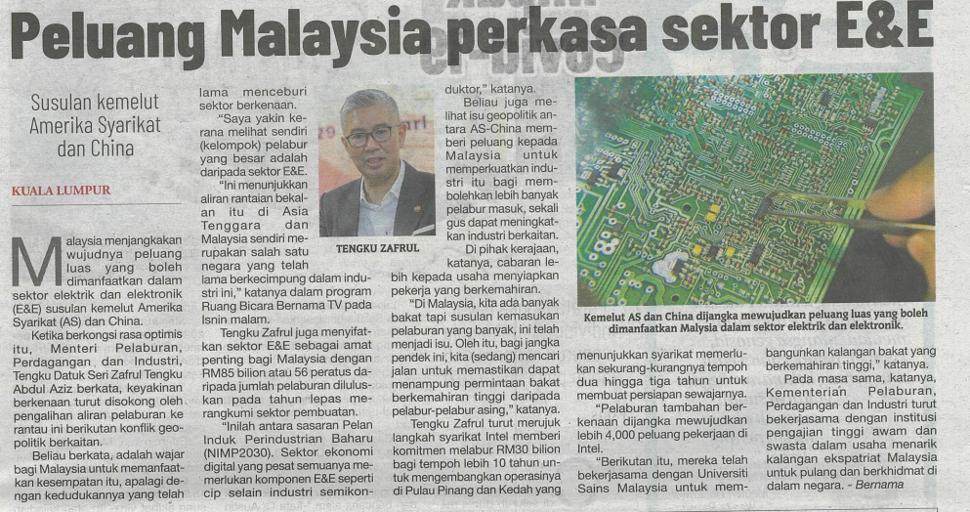
SINAR HARIAN
13 MAC 2024
SH|PELUANG MALAYSIA PERKASA SEKTOR E & E| MS 29

Slide 3
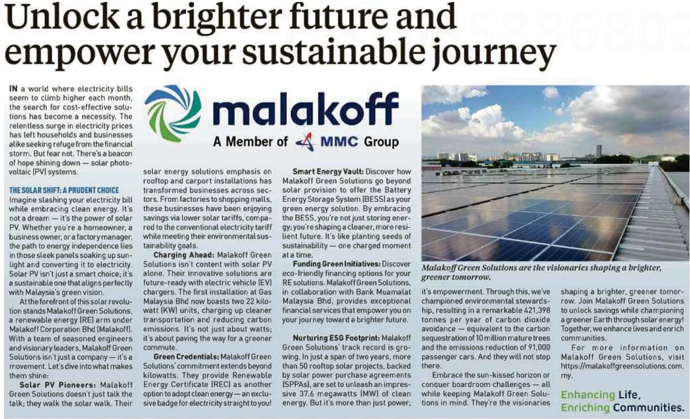
NEW STRAITS TIMES
20 MAC 2024
NST |UNLOCK A BRIGHTER FUTURE AND EMPOWER YOUR SUSTAINABLE JOURNEY| MS 11

Slide 4
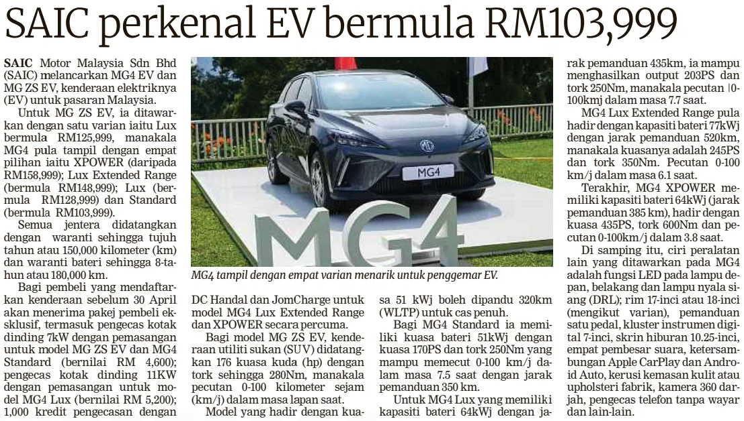
BERITA HARIAN
28 MAC 2024
BH|SAIC PERKENAL EV BERMULA RM103,999| MS 26

