Slide 1
BIL | TAJUK | TARIKH | SURATKHABAR
1 | PASARAN HARTANAH DIJANGKA MENINGKAT 12 PERATUS | 11 JULAI 2025 | BERITA HARIAN
2 | FIRM KEEPS ÓVERWEIGHT’STANCE ON PROPERTY SECTOR | 16 JULAI 2025 | NEW STRAITS TIMES

Slide 2
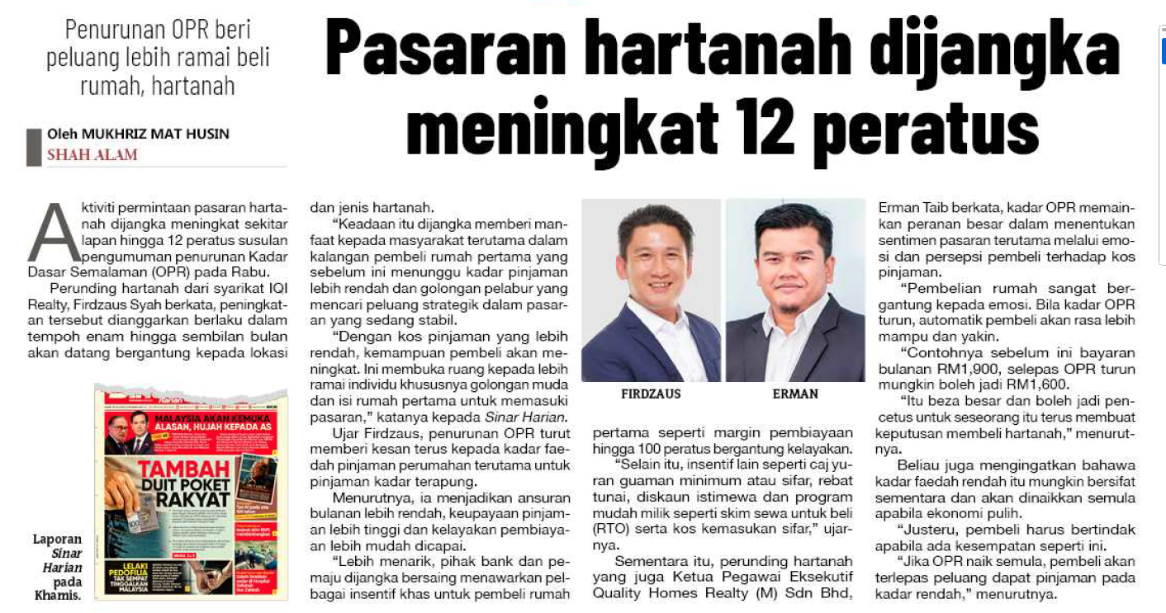
SINAR HARIAN
11 JULAI 2025
SH|PASARAN HARTANAH DIJANGKA MENINGKAT 12 PERATUS| MS 6

Slide 3
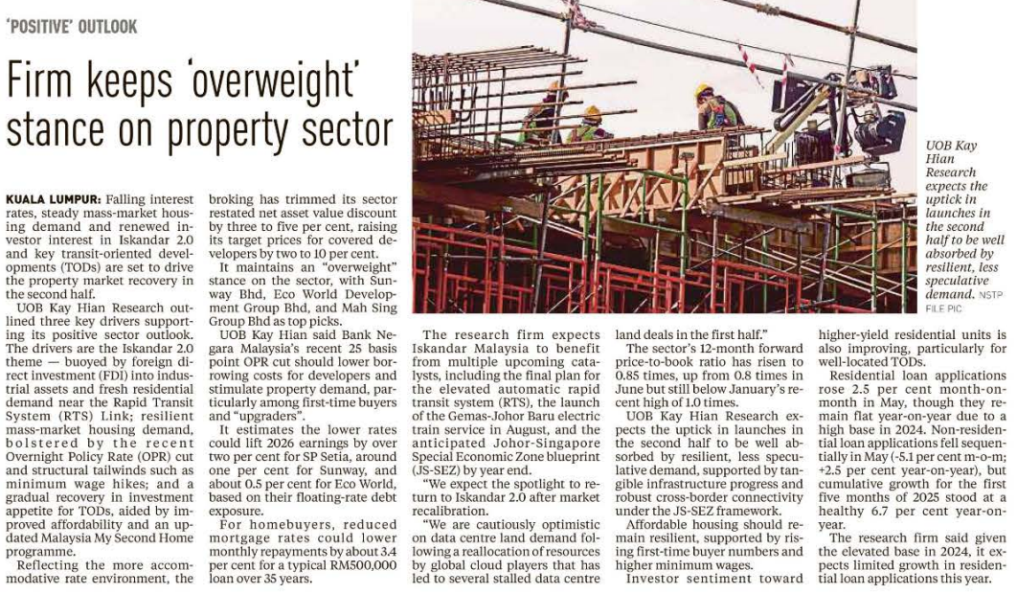
NEW STRAITS TIMES
16 JULAI 2025
NST|FIRM KEEPS ÓVERWEIGHT’STANCE ON PROPERTY SECTOR| MS 6

