Slide 1
BIL | TAJUK | TARIKH | SURATKHABAR
1 | ELECTRIC RAPID BUSES ROLLOUT IN 2026 | 15 JULAI 2025 | NEW STRAITS TIMES
2 | ÓVERWEIGHT’CALL ON POWER INFRASTRUCTURE | 16 JULAI 2025 | NEW STRAITS TIMES
3 | TENAGA SOLAR SOLUSI JIMAT BIL ELEKTRIK, MESRA ALAM | 22 JULAI 2025 | BERITA HARIAN
4 | INDUSTRI ELEKTRIK, ELEKTRONIK TERUS TARIK PELABURAN GLOBAL | 22 JULAI 2025 | BERITA HARIAN
5 | PERANG HARGA EV MAKIN MEMUNCAK | 22 JULAI 2025 | BERITA HARIAN
6 | COST-SAVING, ECO-FRIENDLY SOLUTION | 23 JULAI 2025 | NEW STRAITS TIMES
7 | SEMICONDUCTOR INDUSTRY TO BENEFIT FROM SUPPLY CHAIN FOCUS | 28 JULAI 2025 | NEW STRAITS TIMES
8 | PELABURAN MEGA INFINEON JADIKAN MALAYSIA HAB SEMIKONDUKTOR | 29 JULAI 2025 | BERITA HARIAN

Slide 2
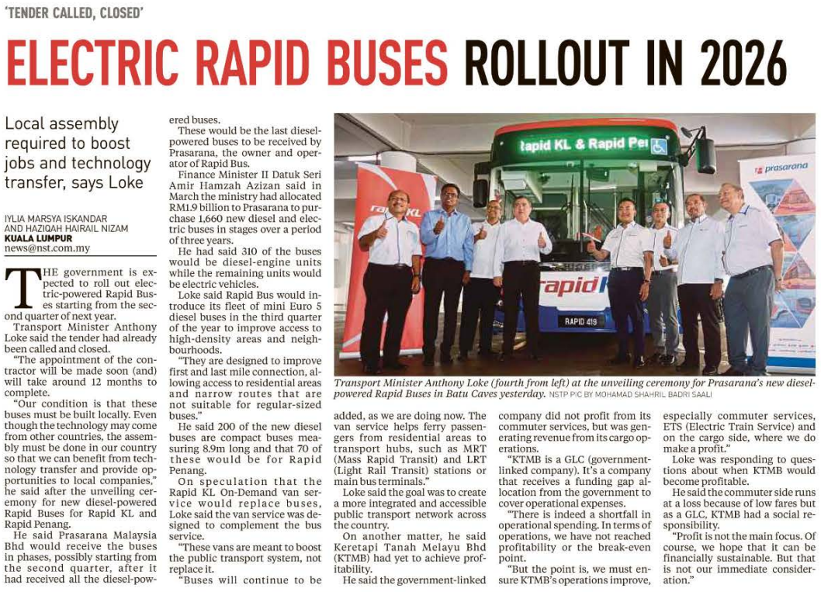
NEW STRAITS TIMES
15 JULAI 2025
NST|ELECTRIC RAPID BUSES ROLLOUT IN 2026| MS 4

Slide 3
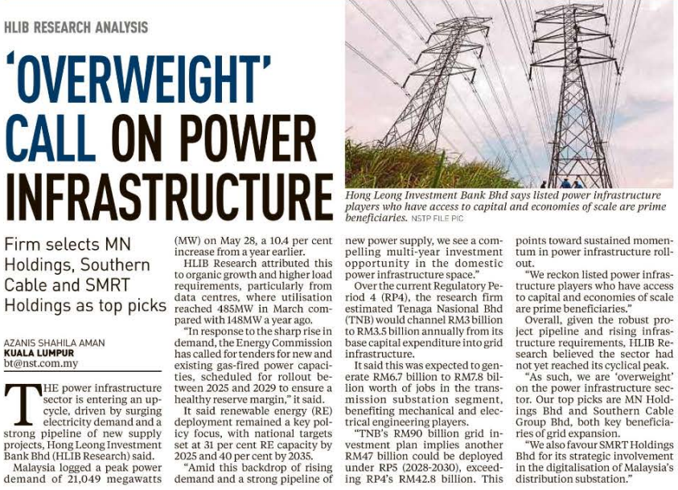
NEW STRAITS TIMES
16 JULAI 2025
NST|ÓVERWEIGHT’CALL ON POWER INFRASTRUCTURE| MS 3

Slide 4
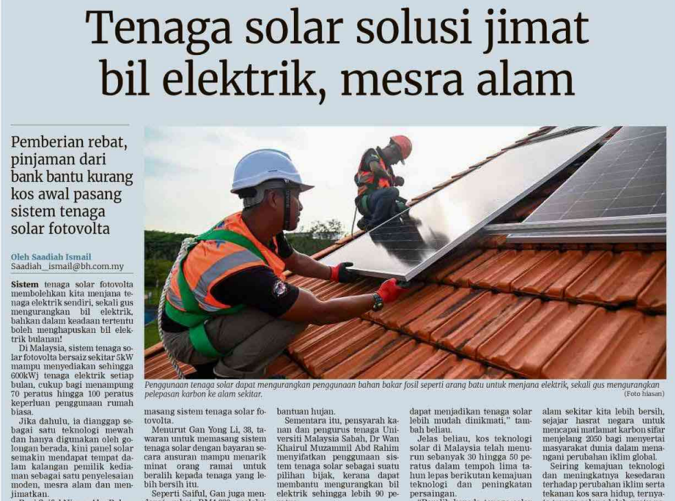
BERITA HARIAN
22 JULAI 2025
BH|TENAGA SOLAR SOLUSI JIMAT BIL ELEKTRIK, MESRA ALAM| MS 7 (SAMBUNG)

Slide 5
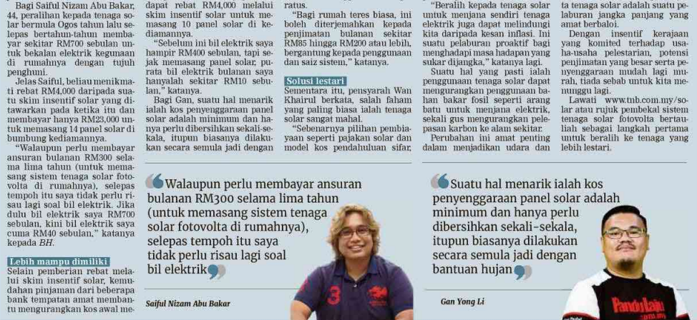
BERITA HARIAN
22 JULAI 2025
BH| TENAGA SOLAR SOLUSI JIMAT BIL ELEKTRIK, MESRA ALAM | MS 7 (SAMBUNGAN)

Slide 6
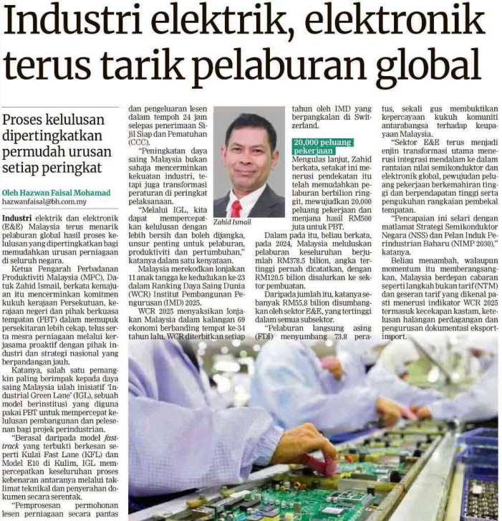
BERITA HARIAN
22 JULAI 2025
BH|INDUSTRI ELEKTRIK, ELEKTRONIK TERUS TARIK PELABURAN GLOBAL| MS 26

Slide 7
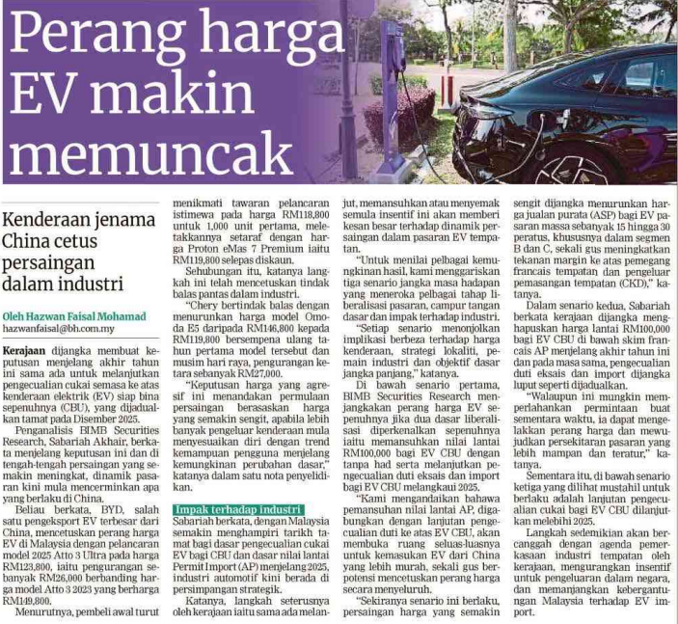
BERITA HARIAN
22 JULAI 2025
BH|PERANG HARGA EV MAKIN MEMUNCAK| MS 27

Slide 8
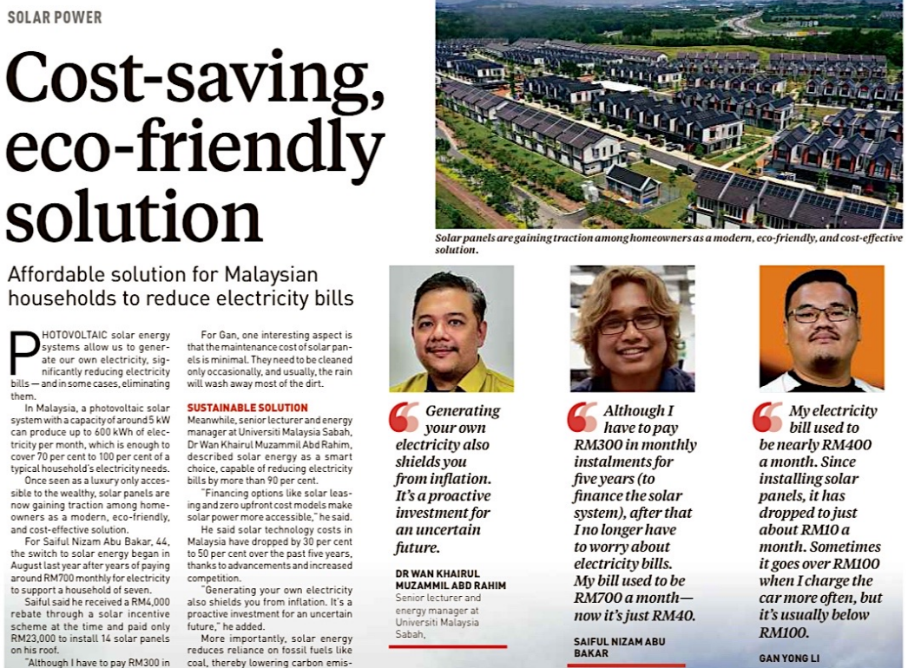
NEW STRAITS TIMES
23 JULAI 2025
NST|COST-SAVING, ECO-FRIENDLY SOLUTION| MS (SAMBUNG)

Slide 9
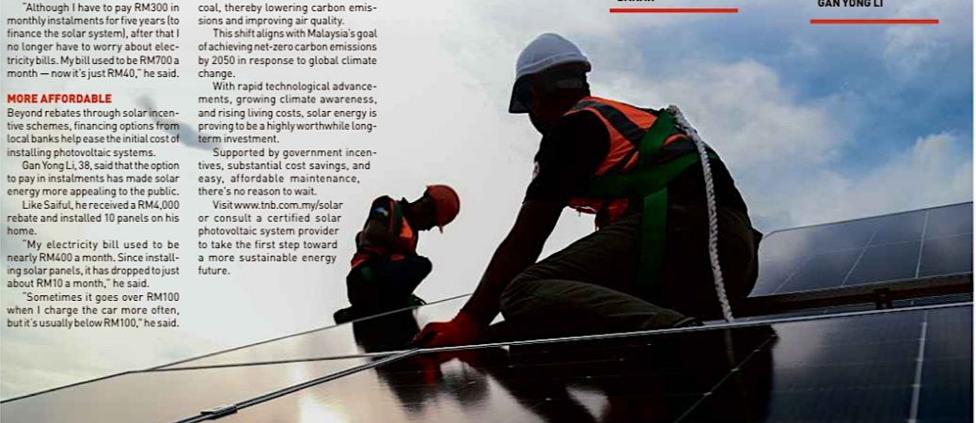
NEW STRAITS TIMES
23 JULAI 2025
NST| COST-SAVING, ECO-FRIENDLY SOLUTION | MS 9 (SAMBUNGAN)

Slide 10
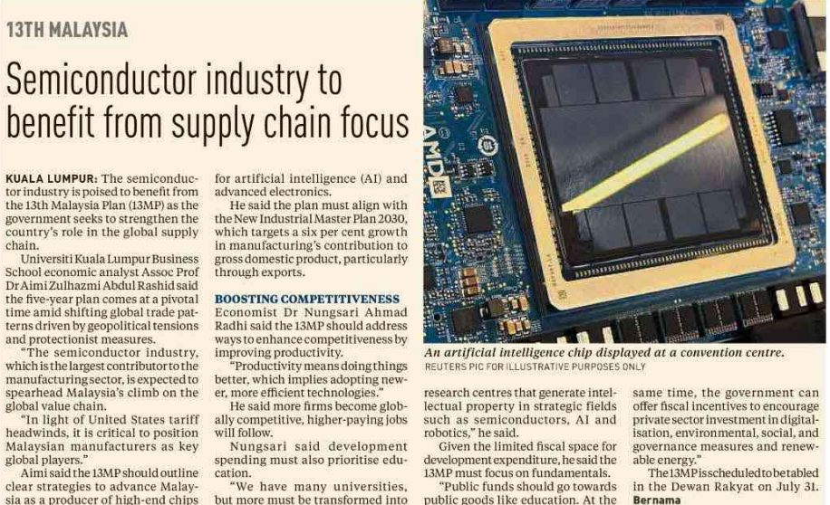
NEW STRAITS TIMES
28 JULAI 2025
NST| SEMICONDUCTOR INDUSTRY TO BENEFIT FROM SUPPLY CHAIN FOCUS| MS 5

Slide 11
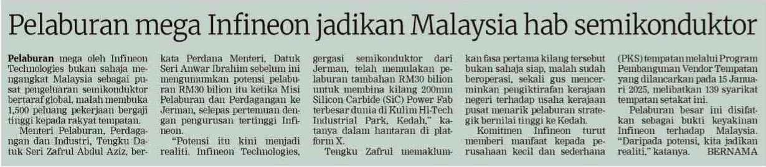
BERITA HARIAN
29 JULAI 2025
BH|PELABURAN MEGA INFINEON JADIKAN MALAYSIA HAB SEMIKONDUKTOR| MS 24

