Slide 1
BIL | TAJUK | TARIKH | SURATKHABAR
1 | PRODUCTIVITY GAME-CHANGER FOR CONSTRUCTION SECTOR | 5 SEPTEMBER 2023 | NEW STRAITS TIMES
2 | PRODUCTIVITY GAME-CHANGER FOR CONSTRUCTION SECTOR..CONTINUED.. | 5 SEPTEMBER 2023 | NEW STRAITS TIMES
3 | JOHOR ‘LUBUK REZEKI’ KONTRAKTOR TEMPATAN | 26 SEPTEMBER 2023 | BERITA HARIAN
4 | TEROWONG GENTING 16.39KM LANDASAN TREN TERPANJANG DI ASIA | 27 SEPTEMBER 2023 | BERITA HARIAN

Slide 2
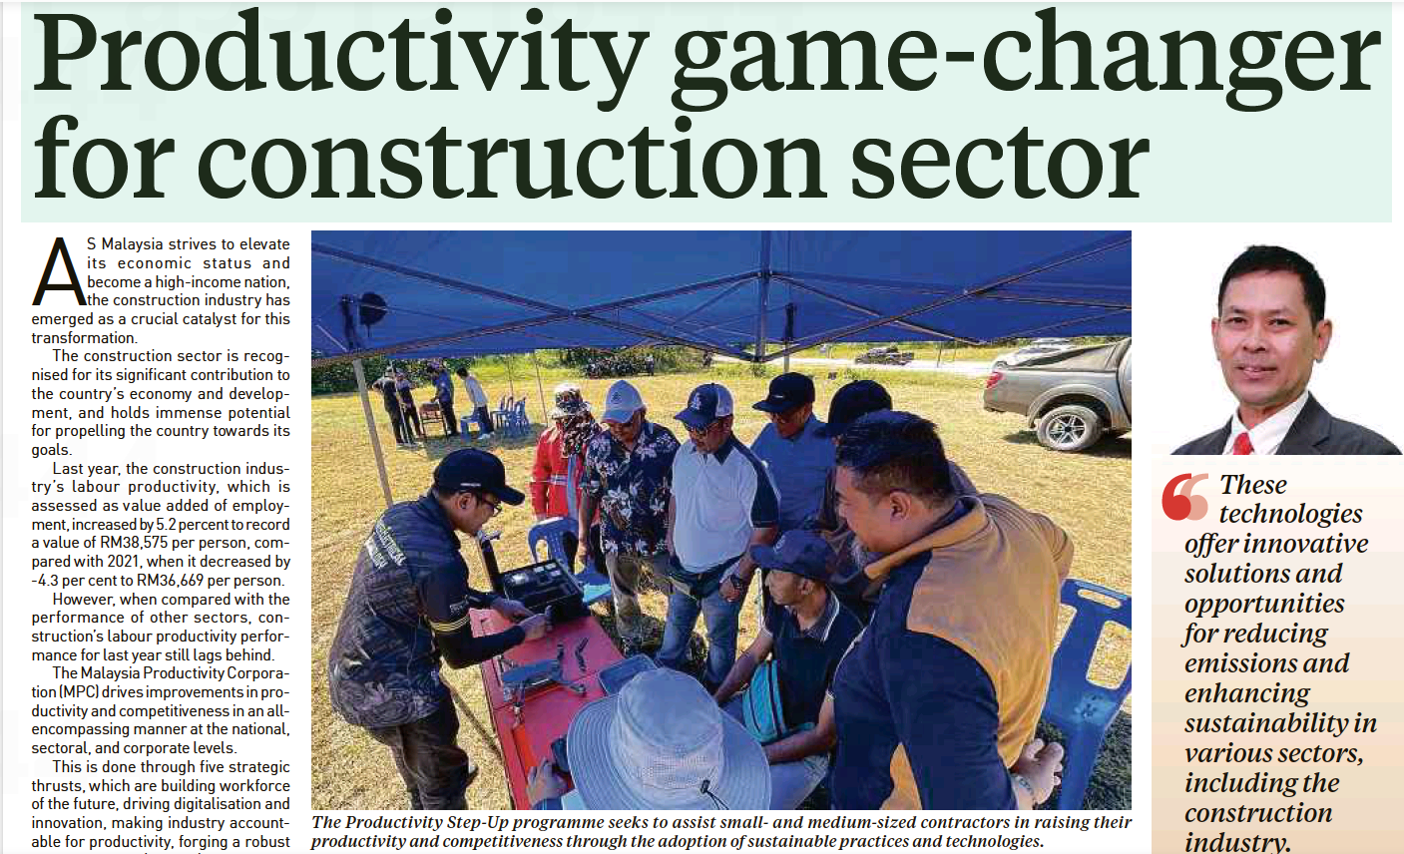
NEW STRAITS TIMES
5 SEPTEMBER 2023
NST|PRODUCTIVITY GAME-CHANGER FOR CONSTRUCTION SECTOR| MS 10

Slide 3
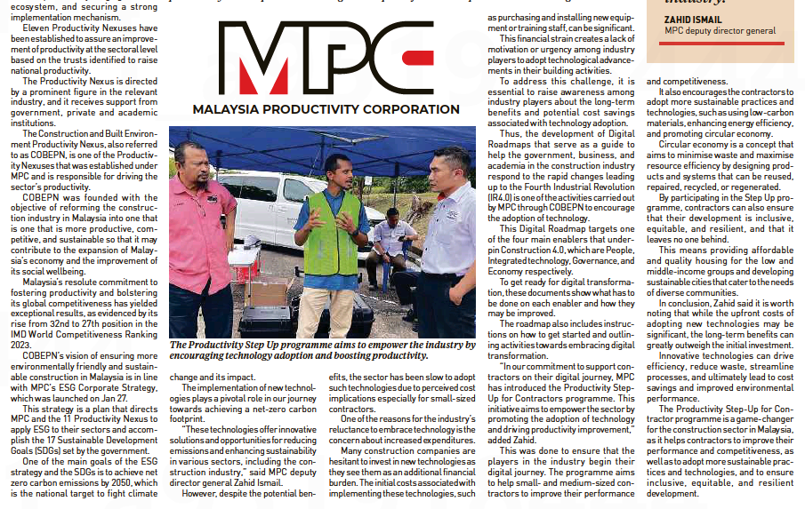
NEW STRAITS TIMES
5 SEPTEMBER 2023
NST|PRODUCTIVITY GAME-CHANGER FOR CONSTRUCTION SECTOR..CONTINUED| MS 10

Slide 4
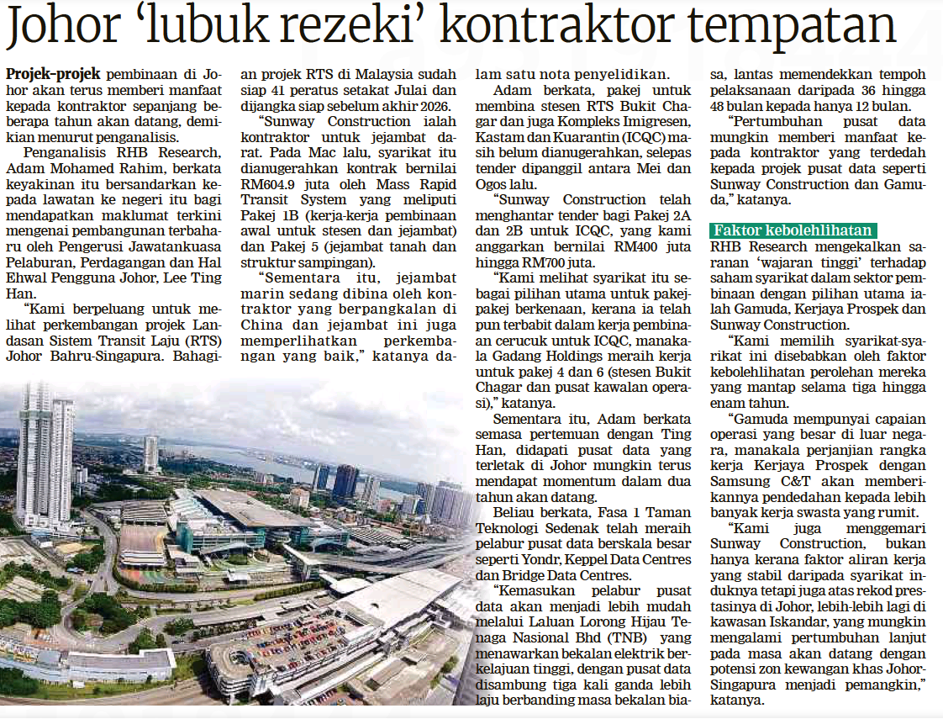
BERITA HARIAN
26 SEPTEMBER 2023
BH|JOHOR ‘LUBUK REZEKI’ KONTRAKTOR TEMPATAN| MS 24

Slide 5
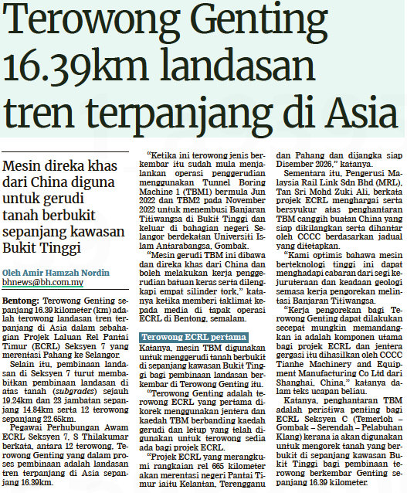
BERITA HARIAN
27 SEPTEMBER 2023
BH|TEROWONG GENTING 16.39KM LANDASAN TREN TERPANJANG DI ASIA| MS16

