Slide 1
BIL | TAJUK | TARIKH | SURATKHABAR
1 | TINGKAT TENAGA MAHIR BERASASKAN TEKNOLOGI | 4 SEPTEMBER 2023 | BERITA HARIAN
2 | PROGRESSTURE AIMS TO BECOME MAJOR PLAYER | 4 SEPTEMBER 2023 | NEW STRAITS TIMES
3 | MITI JAMIN LINDUNGI KEPENTINGAN DOMESTIK | 5 SEPTEMBER 2023 | BERITA HARIAN
4 | IS A UNIVERSAL CHARGER FOR Evs ON THE HORIZON? | 5 SEPTEMBER 2023 | NEW STRAITS TIMES
5 | LADANG TENAGA DI JALAN RAYA | 7 SEPTEMBER 2023 | SINAR HARIAN
6 | TECHNICIAN SHORTAGE A PROBLEM | 7 SEPTEMBER 2023 | NEW STRAITS TIMES
7 | POTENSI PASARAN EV MALAYSIA BAKAL MELONJAK | 8 SEPTEMBER 2023 | SINAR HARIAN
8 | POTENSI PASARAN EV MALAYSIA BAKAL MELONJAK..SAMBUNGAN.. | 8 SEPTEMBER 2023 | SINAR HARIAN
9 | MITI HARAP INSENTIF EV DALAM BELANJAWAN 2024 | 11 SEPTEMBER 2023 | BERITA HARIAN
10 | KERAJAAN BANTU INDUSTRI JIMAT KOS GUNA TENAGA | 14 SEPTEMBER 2023 | BERITA HARIAN
11 | PERAK MILIKI KAPASITI SOLAR BERSKALA BESAR TERTINGGI | 25 SEPTEMBER 2023 | BERITA HARIAN
12 | HARGA SEDERHANA ARANG BATU PERKUKUH KEWANGAN TNB | 27 SEPTEMBER 2023 | BERITA HARIAN
13 | MAA SYOR INSENTIF UNTUK KENDERAAN ELEKTRIFIKASI | 29 SEPTEMBER 2023 | BERITA HARIAN

Slide 2
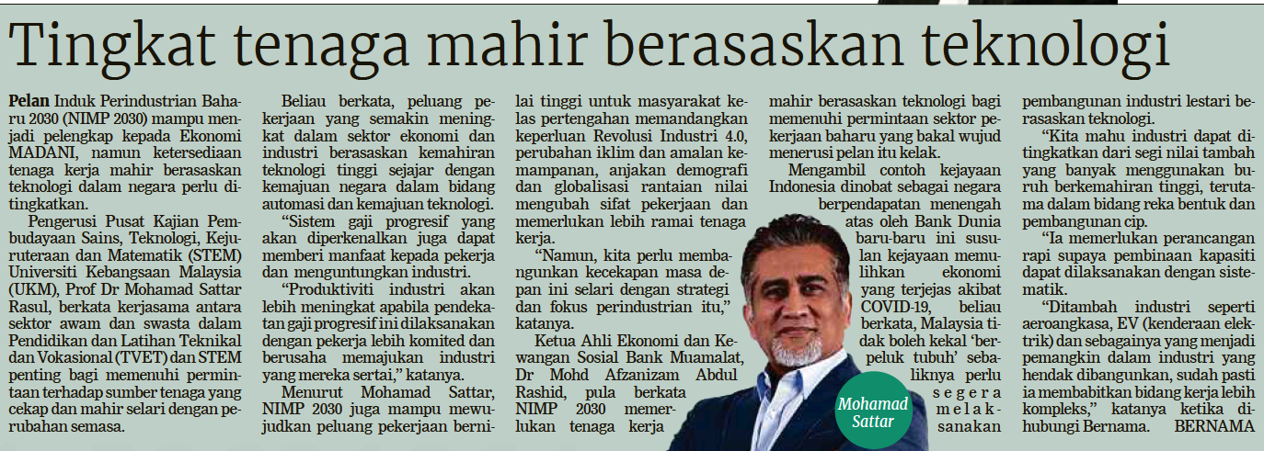
BERITA HARIAN
4 SEPTEMBER 2023
BH |TINGKAT TENAGA MAHIR BERASASKAN TEKNOLOGI| MS 23

Slide 3
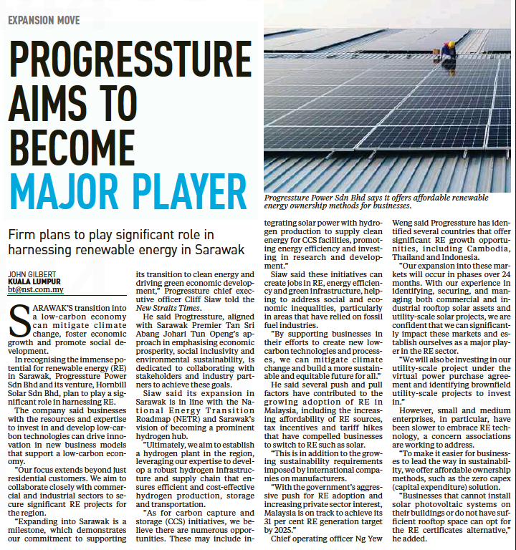
NEW STRAITS TIMES
4 SEPTEMBER 2023
NST|PROGRESSTURE AIMS TO BECOME MAJOR PLAYER| MS 22

Slide 4
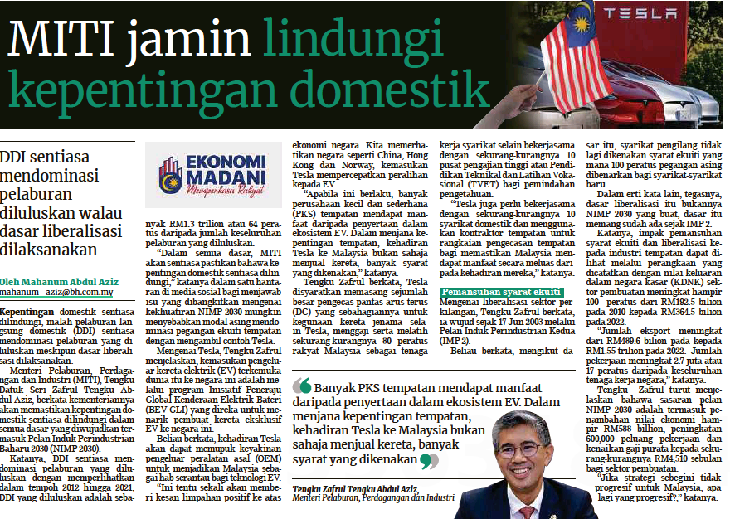
BERITA HARIAN
5 SEPTEMBER 2023
BH|MITI JAMIN LINDUNGI KEPENTINGAN DOMESTIK |MS 26

Slide 5
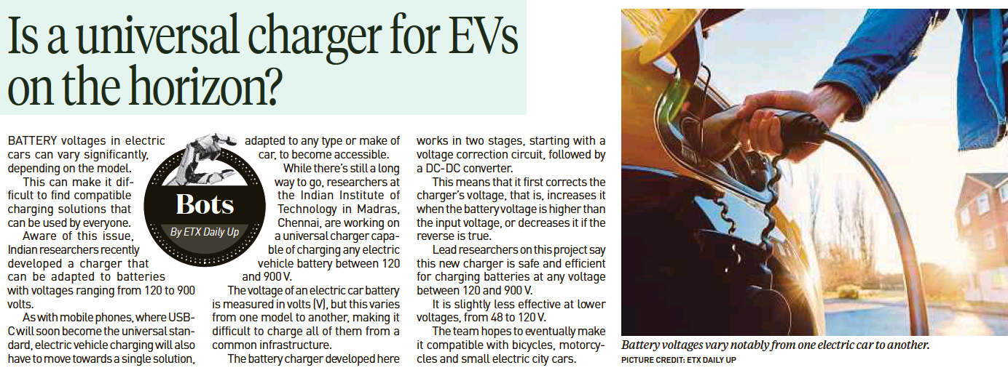
NEW STRAITS TIMES
5 SEPTEMBER 2023
NST|IS A UNIVERSAL CHARGER FOR Evs ON THE HORIZON?| MS11

Slide 6
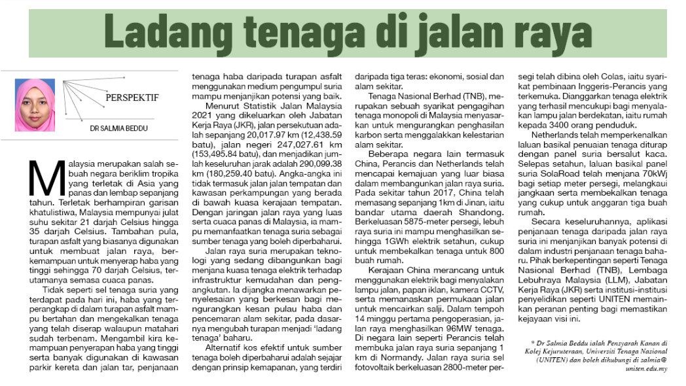
SINAR HARIAN
7 SEPTEMBER 2023
SH|LADANG TENAGA DI JALAN RAYA|MS 17

Slide 7
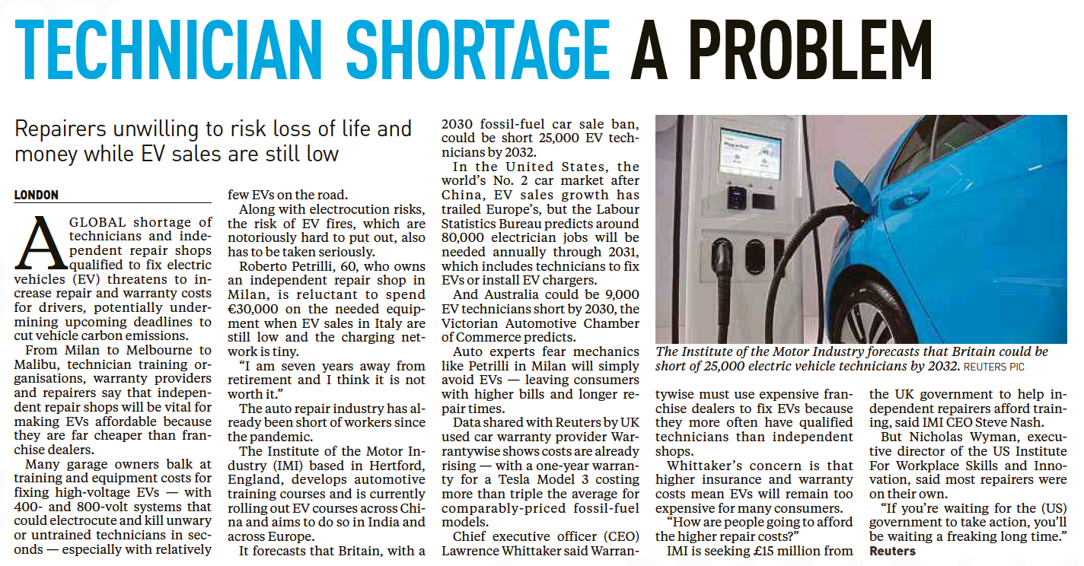
NEW STRAITS TIMES
7 SEPTEMBER 2023
NST|TECHNICIAN SHORTAGE A PROBLEM| MS 24

Slide 8
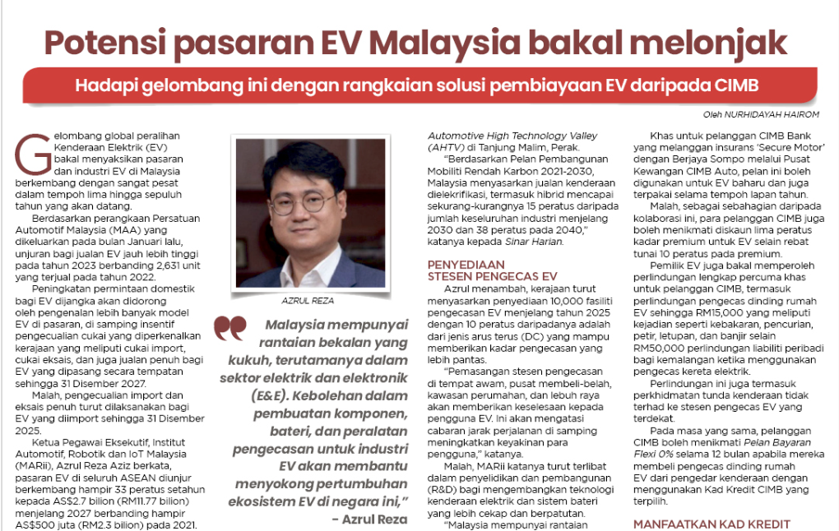
SINAR HARIAN
8 SEPTEMBER 2023
SH|POTENSI PASARAN EV MALAYSIA BAKAL MELONJAK| MS 9

Slide 9
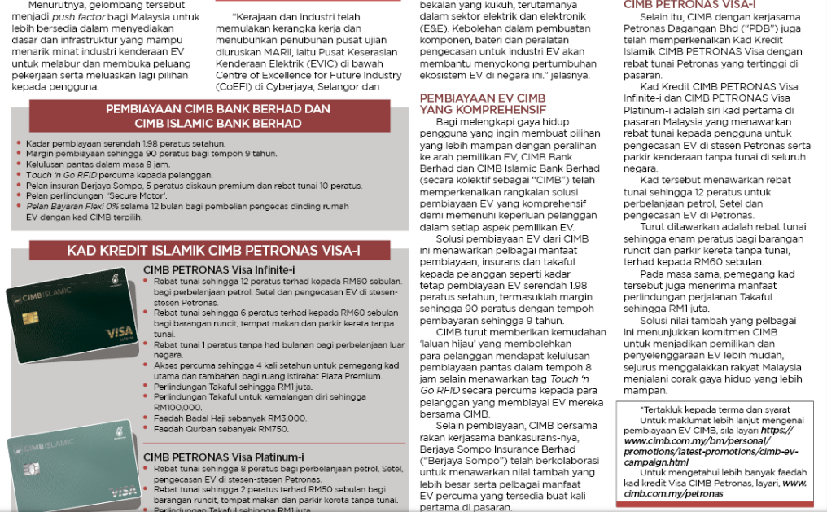
SINAR HARIAN
8 SEPTEMBER 2023
SH|POTENSI PASARAN EV MALAYSIA BAKAL MELONJAK..SAMBUNGAN…| MS 9

Slide 10
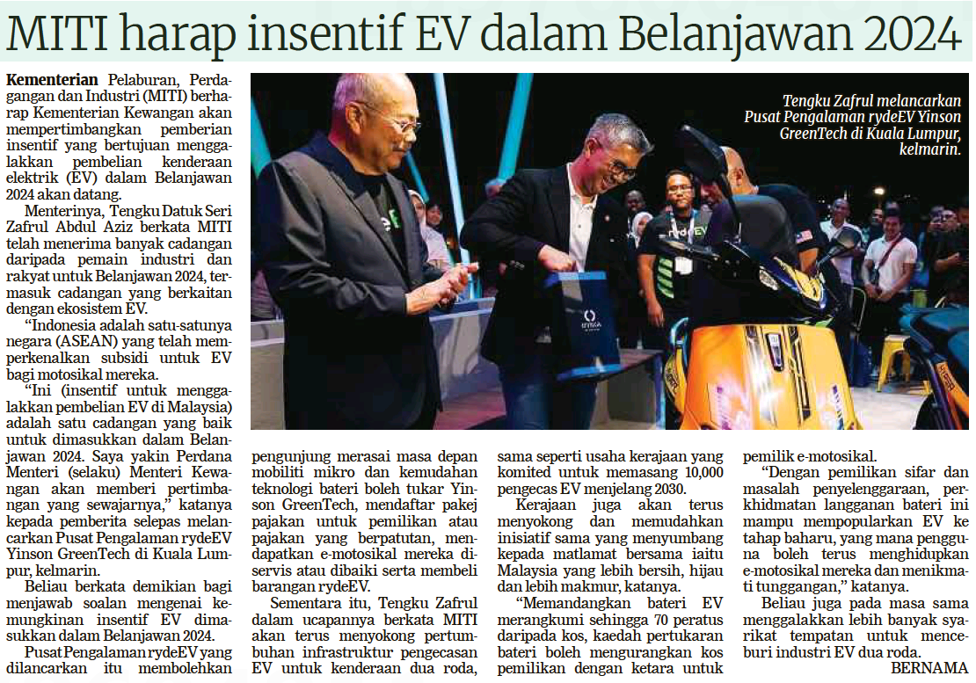
BERITA HARIAN
11 SEPTEMBER 2023
BH|MITI HARAP INSENTIF EV DALAM BELANJAWAN 2024|MS 24

Slide 11
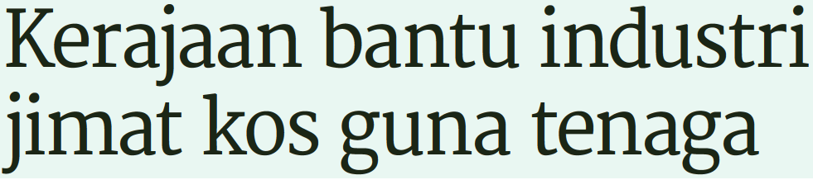
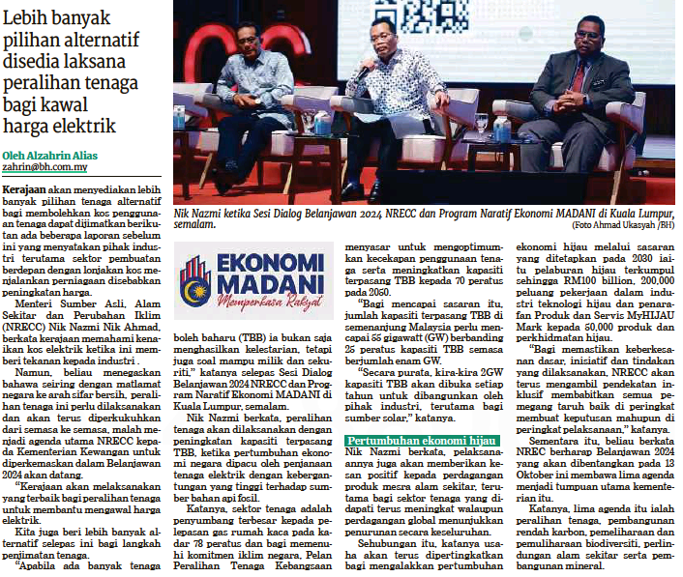
BERITA HARIAN
14 SEPTEMBER 2023
BH|KERAJAAN BANTU INDUSTRI JIMAT KOS GUNA TENAGA|MS 12

Slide 12
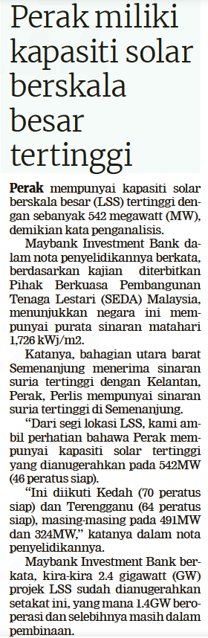
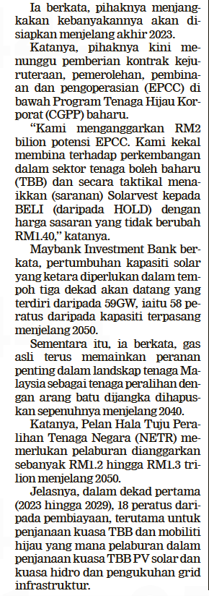
BERITA HARIAN
25 SEPTEMBER 2023
BH|PERAK MILIKI KAPASITI SOLAR BERSKALA BESAR TERTINGGI| MS 24

Slide 13
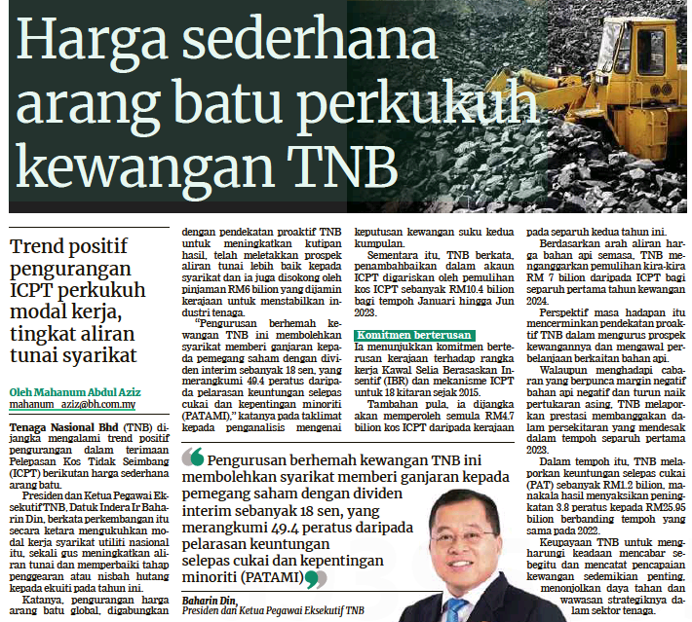
BERITA HARIAN
27 SEPTEMBER 2023
BH|HARGA SEDERHANA ARANG BATU PERKUKUH KEWANGAN TNB| MS 27

Slide 14
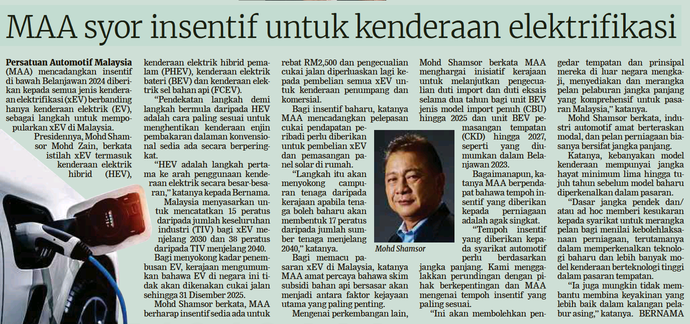
BERITA HARIAN
29 SEPTEMBER 2023
BH|MAA SYOR INSENTIF UNTUK KENDERAAN ELEKTRIFIKASI| MS 29

