Slide 1
BIL | TAJUK | TARIKH | SURATKHABAR
1 | PLANTING THE SEEDS OF ROBOTICS IN AGRICULTURE | 20 OKTOBER 2023 | NEW STRAITS TIMES

Slide 2
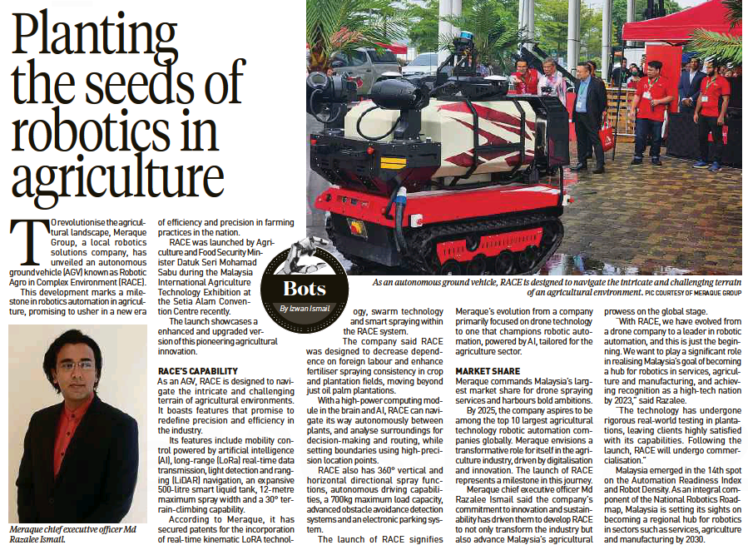
NEW STRAITS TIMES
16 OKTOBER 2023
NST|PLANTING THE SEEDS OF ROBOTICS IN AGRICULTURE| MS 11

