Slide 1
BIL | TAJUK | TARIKH | SURATKHABAR
1 | HOSPITAL SELAYANG HOSPITAL PERTAMA GUNA PARKIR MEKANIKAL | 6 JULAI 2023 | SINAR HARIAN
2 | MAKING FACTORIES SMARTER | 14 JULAI 2023 | NEW STRAITS TIMES

Slide 2
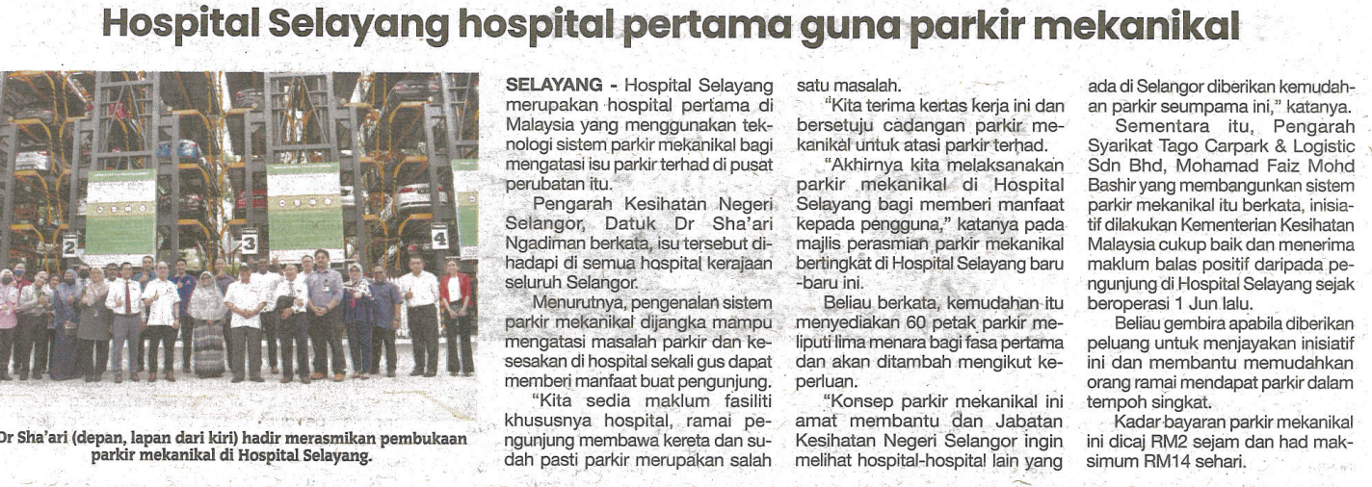
SINAR HARIAN
6 JULAI 2023
SH|HOSPITAL SELAYANG HOSPITAL PERTAMA GUNA PARKIR MEKANIKAL| MS 23

Slide 3
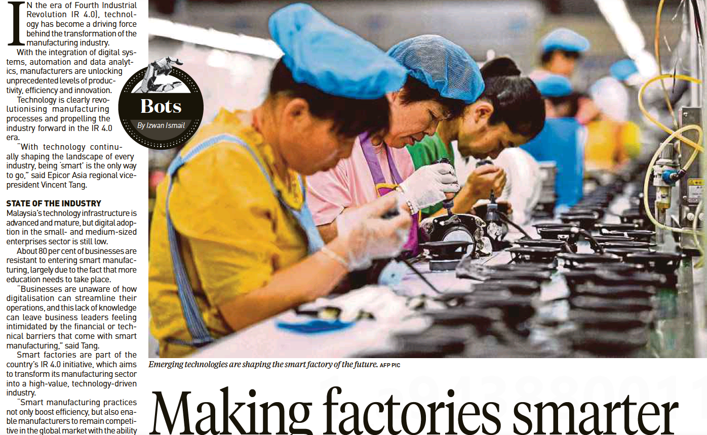
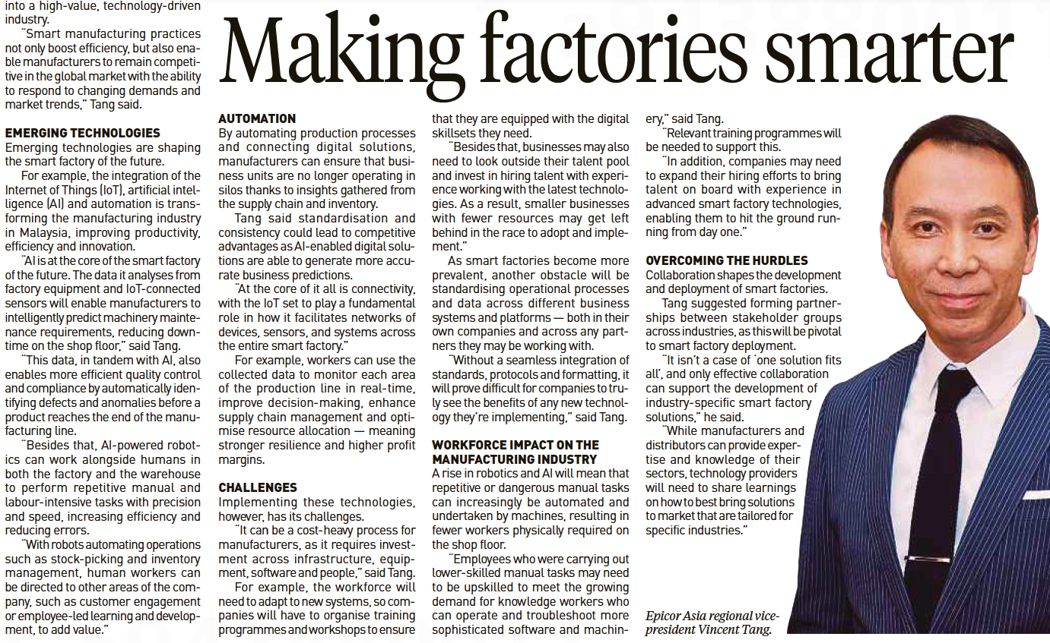
NEWS STRAITS TIMES
14 JULAI 2023
NST|MAKING FACTORIES SMARTER| MS 12

