Slide 1
BIL | TAJUK | TARIKH | SURATKHABAR
1. | DECISION MAY RESHAPE PROPERTY MARKET | 8 MEI 2025 | NEW STRAITS TIMES

Slide 2
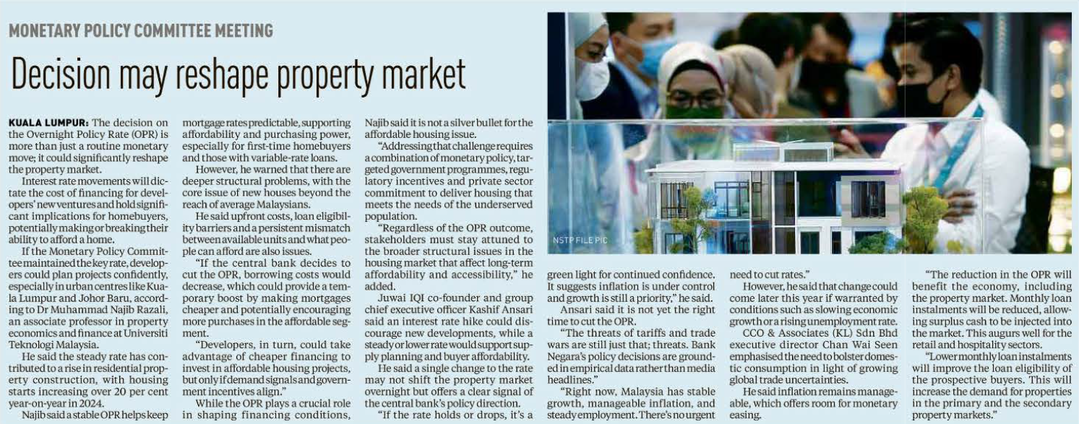
NEW STRAITS TIMES
8 MEI 2025
NST|DECISION MAY RESHAPE PROPERTY MARKET| MS 4

