Slide 1
BIL | TAJUK | TARIKH | SURATKHABAR
1 | KDEBWM PERKENAL LORI EURO 5 | 30 APRIL 2025 | SINAR HARIAN

Slide 2
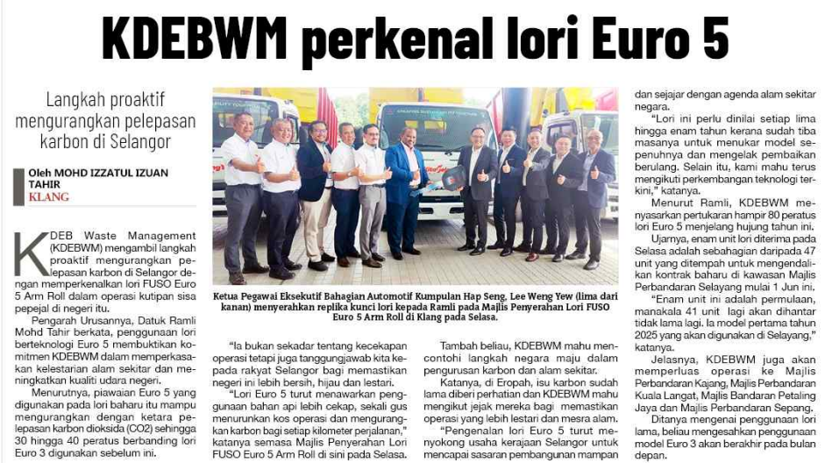
SINAR HARIAN
30 APRIL 2025
SH|KDEBWM PERKENAL LORI EURO 5| MS 30

