Slide 1
BIL | TAJUK | TARIKH | SURATKHABAR
1 | PROTON TELITI MODEL EV BAHARU SELEPAS KEJAYAAN e-MAS7 | 3 APRIL 2025 | BERITA HARIAN
2 | TNB TAWAR REBAT 100 PERATUS SATU BULAN BIL | 4 APRIL 2025 | BERITA HARIAN
3 | PRODUK SOLAR MALAYSIA KENE CUKAI TAMBAHAN | 23 APRIL 2025 | SINAR HARIAN
4 | IMPLIKASI BESAR DUTI SOLAR AS | 24 APRIL 2025 | SINAR HARIAN

Slide 2
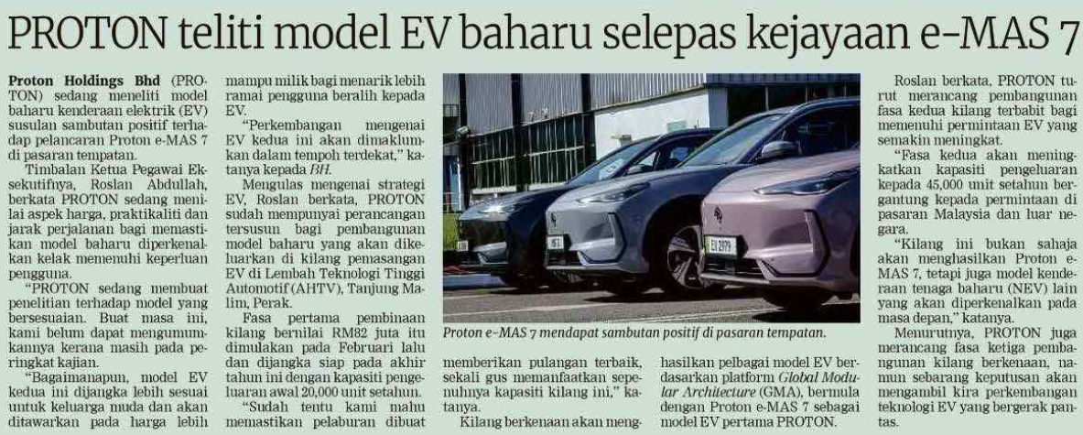
BERITA HARIAN
3 APRIL 2025
BH|PROTON TELITI MODEL EV BAHARU SELEPAS KEJAYAAN e-MAS7|MS 21

Slide 3
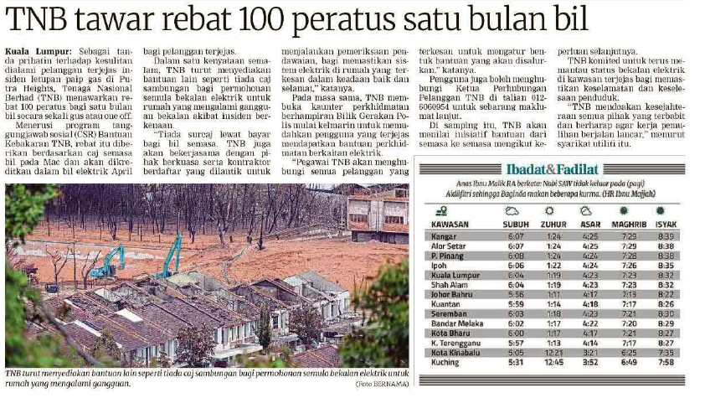
BERITA HARIAN
4 APRIL 2025
BH|TNB TAWAR REBAT 100 PERATUS SATU BULAN BIL|MS 7

Slide 4
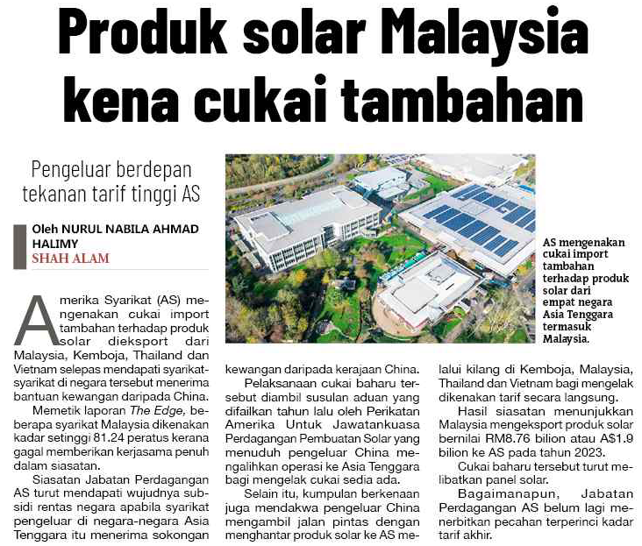
SINAR HARIAN
23 APRIL 2025
SH|PRODUK SOLAR MALAYSIA KENE CUKAI TAMBAHAN|MS 4

Slide 5
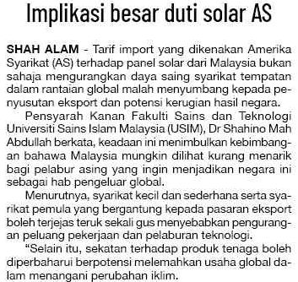
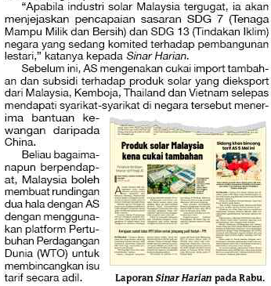
SINAR HARIAN
24 APRIL 2025
SH|IMPLIKASI BESAR DUTI SOLAR AS|MS 5

