Slide 1
BIL | TAJUK | TARIKH | SURATKHABAR
1 | INOVASI PELAJAR POLITEKNIK JELI CIPTA SEJARAH | 4 OGOS 2026 | SINAR HARIAN
2 | PERTUMBUHAN EV PERLU SEIRING INFRASTRUKTUR | 6 OGOS 2026 | BERITA HARIAN
3 | ALAM FLORA PERLUAS TEKNOLOGI HIJAU DEMI KELESTARIAN ALAM | 10 OGOS 2026 | BERITA HARIAN
4 | MITI BOLSTERS MALAYSIA KEY POSITION IN GLOBAL E&E SUPPLY CHAIN | 11 OGOS 2026 | NEW STRAITS TIMES
5 | NEEAP 2.0 SASAR PENJIMATAN UTILITI RM85.24b | 12 OGOS 2026 | BERITA HARIAN
6 | SHOULD THE GOVT CHARGE THE PEOPLE TO CHARGE THEIR EVs?| | 14 OGOS 2026 | NEW STRAITS TIMES
7 | McDonald’s, TNB PERKUKUH KERJASAMA STARTEGIK | 25 OGOS 2026 | SINAR HARIAN

Slide 2
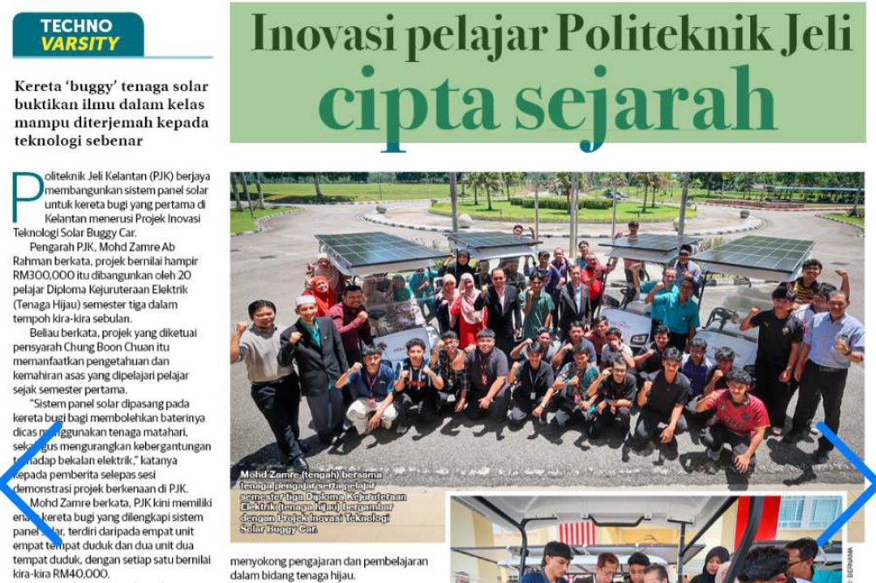
SINAR HARIAN
4 OGOS 2026
SH|INOVASI PELAJAR POLITEKNIK JELI CIPTA SEJARAH| MS 17 (SAMBUNG)

Slide 3
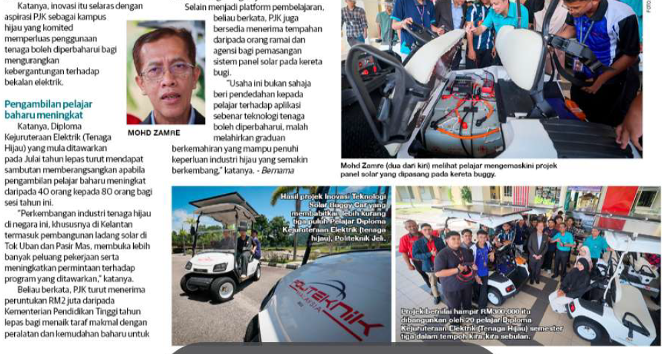
SINAR HARIAN
4 OGOS 2026
SH|INOVASI PELAJAR POLITEKNIK JELI CIPTA SEJARAH |MS 17 (SAMBUNGAN)

Slide 4
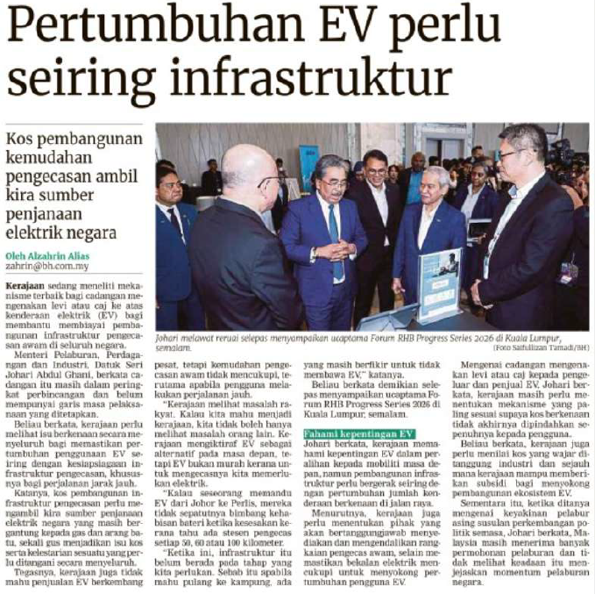
BERITA HARIAN
6 OGOS 2026
BH|PERTUMBUHAN EV PERLU SEIRING INFRASTRUKTUR|MS 23

Slide 5
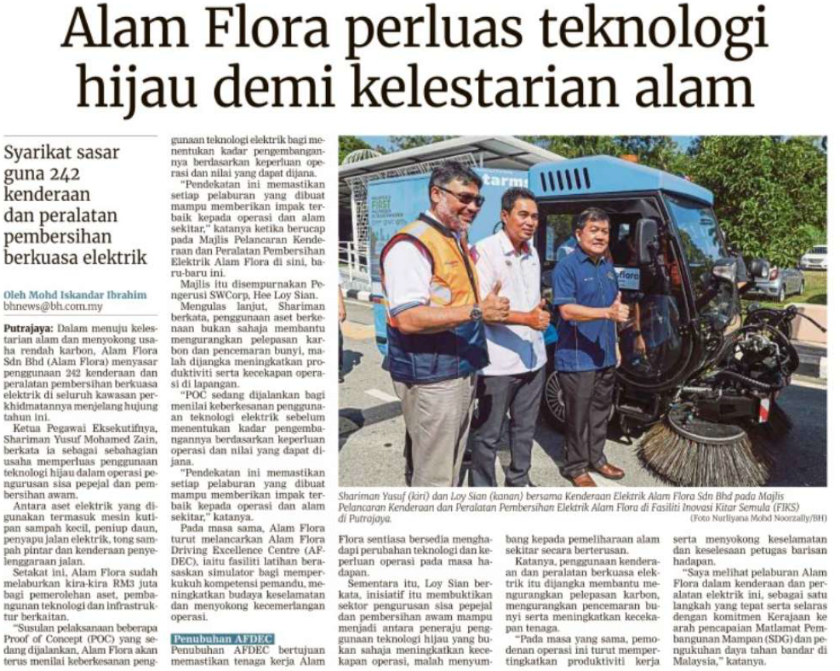
BERITA HARIAN
10 OGOS 2026
BH|ALAM FLORA PERLUAS TEKNOLOGI HIJAU DEMI KELESTARIAN ALAM|MS 13

Slide 6
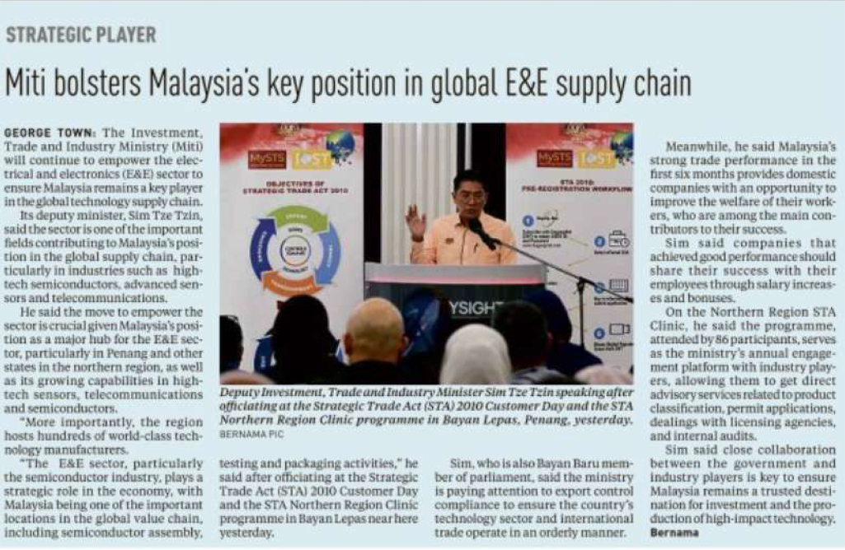
NEW STRAITS TIMES
11 AUGUST 2026
NST|MITI BOLSTERS MALAYSIAÁ KEY POSITION IN GLOBAL E&E SUPPLY CHAIN|MS 2

Slide 7
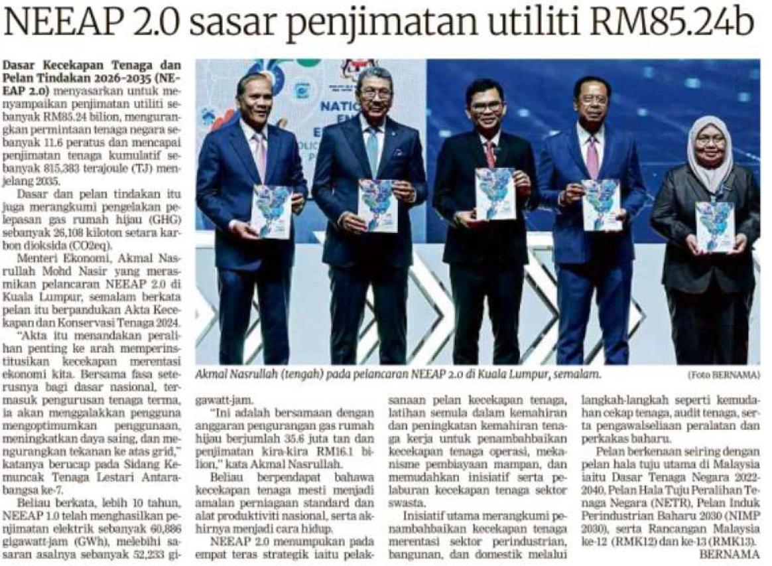
BERITA HARIAN
12 OGOS 2026
BH|NEEAP 2.0 SASAR PENJIMATAN UTILITI RM85.24b| MS 26

Slide 8
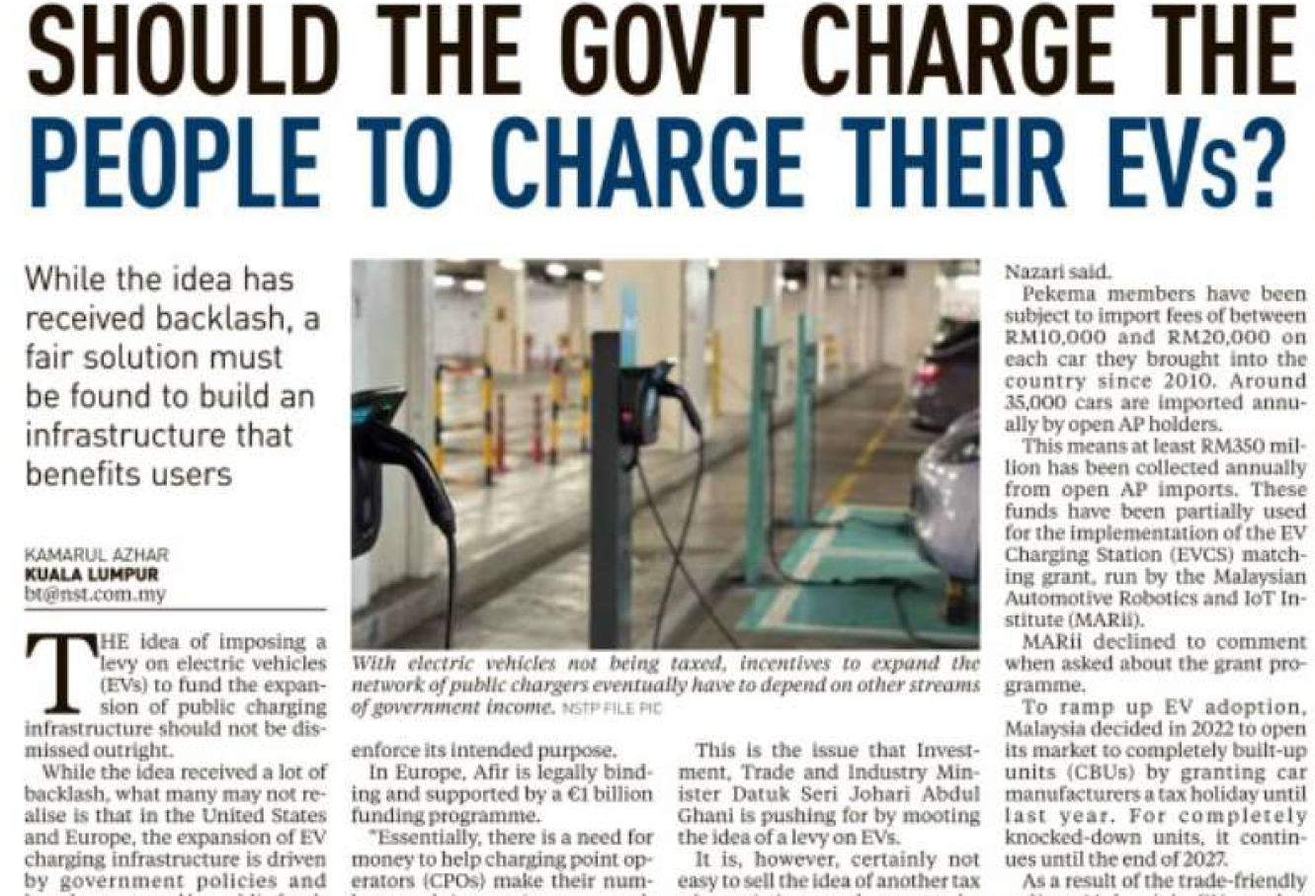
NEW STRAITS TIMES
14 AUGUST 2026
NST|SHOULD THE GOVT CHARGE THE PEOPLE TO CHARGE THEIR EVs?| MS 2

Slide 9
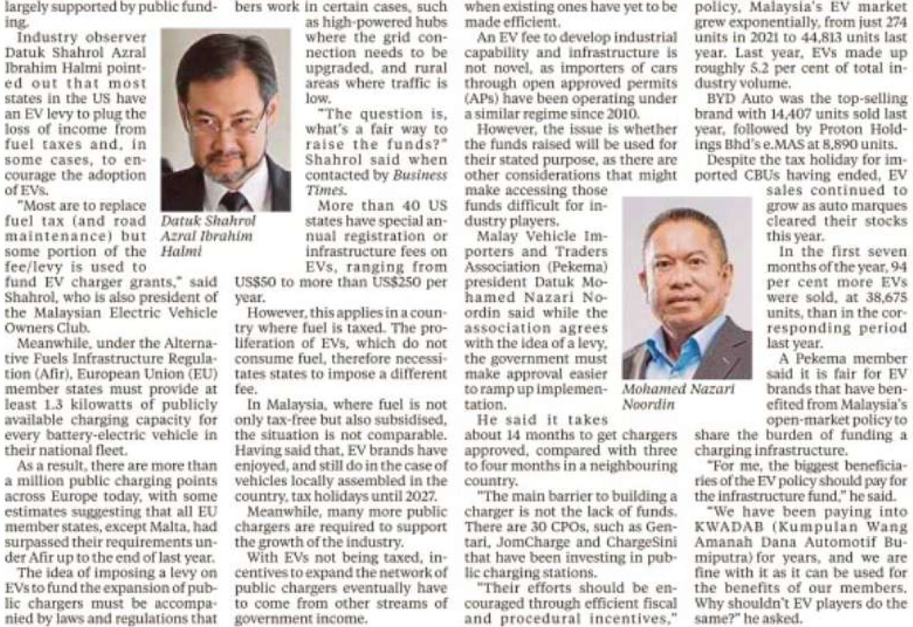
NEW STRAITS TIMES
14 AUGUST 2026
NST|SHOULD THE GOVT CHARGE THE PEOPLE TO CHARGE THEIR EVs?| MS 2 (CONTINUED)

