Slide 1
BIL | TAJUK | TARIKH | SURATKHABAR
1 | AI BUKAN MUSUH | 6 OGOS 2026 | SINAR HARIAN
2 | PERKUKUH KEDUDUKAN MALAYSIA DALAM RANGKAIAN AI | 6 OGOS 2026 | BERITA HARIAN
3 | MALAYSIA BERPONTESI JADI PENERAJU AI DIGITAL ASEAN | 7 OGOS 2026 | BERITA HARIAN
4 | TRANSFORMASI TEKNOLOGI UBAH LANDSKAP KERJAYA | 10 OGOS 2026 | BERITA HARIAN
5 | INNOPRENEUR 4.0 ASAH BAKAT INOVASI PELAJAR | 10 OGOS 2026 | BERITA HARIAN
6 | GROWING THREAT OF FAKE SOCAL MEDIA ACCOUNTS | 11 OGOS 2026 | NEW STRAITS TIMES
7 | MALAYSIA OVERHAULS PROPERTY LAWS | 11 OGOS 2026 | NEW STRAITS TIMES
8 | MALAYSIA’S NEXT DIGITAL CHALLENGE IS BUILDING TRUST AS AI RESHAPES THE FUTURE | 12 OGOS 2026 | SINAR HARIAN
9 | TANGANI SERANGAN BERSENJATA DI SEKOLAH | 13 OGOS 2026 | SINAR HARIAN
10 | KERANGKA PERUNDANGAN SETARA PERKUKUH TADBIR URUS IPT | 17 OGOS 2026 | SINAR HARIAN
11 | MANSUH AUKU JAMIN KEBEBASAN AKADEMIK | 17 OGOS 2026 | SINAR HARIAN
12 | MENDAKI AQABAH, MEMBINA UMMAH | 17 OGOS 2026 | SINAR HARIAN
13 | BUKA RUANG LUAS SUARA MAHASISWA | 17 OGOS 2026 | SINAR HARIAN
14 | AL-QURAN PANDUAN BINA KEKUATAN | 18 OGOS 2026 | SINAR HARIAN
11 | AKTA BAHARU GANTI AUKU TAK KONGKONG MAHASISWA, PELAJAR | 20 OGOS 2026 | BERITA HARIAN
12 | SEPADUKAN KURSUS LINGUISTIK, IT PERKASA BAHASA MELAYU ERA DIGITAL | 20 OGOS 2026 | BERITA HARIAN
13 | JAWATANKUASA BEBAS TELITI AKTA BAHARU GANTI AUKU | 21 OGOS 2026 | BERITA HARIAN
14 | PERTUMBUHAN 6 PERATUS SEKTOR AI BERI MANFAAT PEMBANGUNAN | 28 OGOS 2026 | BERITA HARIAN

Slide 2
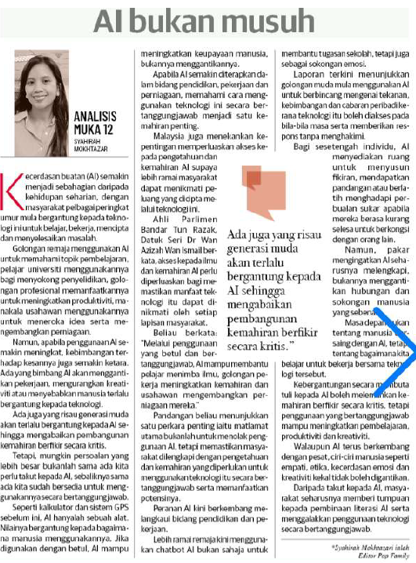
SINAR HARIAN
6 OGOS 2026
SH|AI BUKAN MUSUH|MS 12

Slide 3
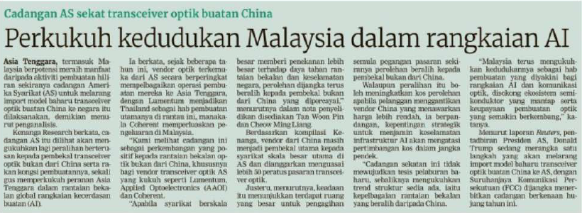
BERITA HARIAN
6 OGOS 2026
BH|PERKUKUH KEDUDUKAN MALAYSIA DALAM RANGKAIAN AI|MS 22

Slide 4
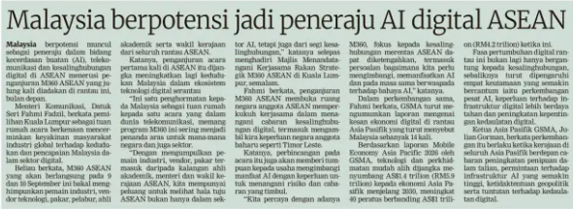
BERITA HARIAN
7 OGOS 2026
BH|MALAYSIA BERPONTESI JADI PENERAJU AI DIGITAL ASEAN| MS 23

Slide 5
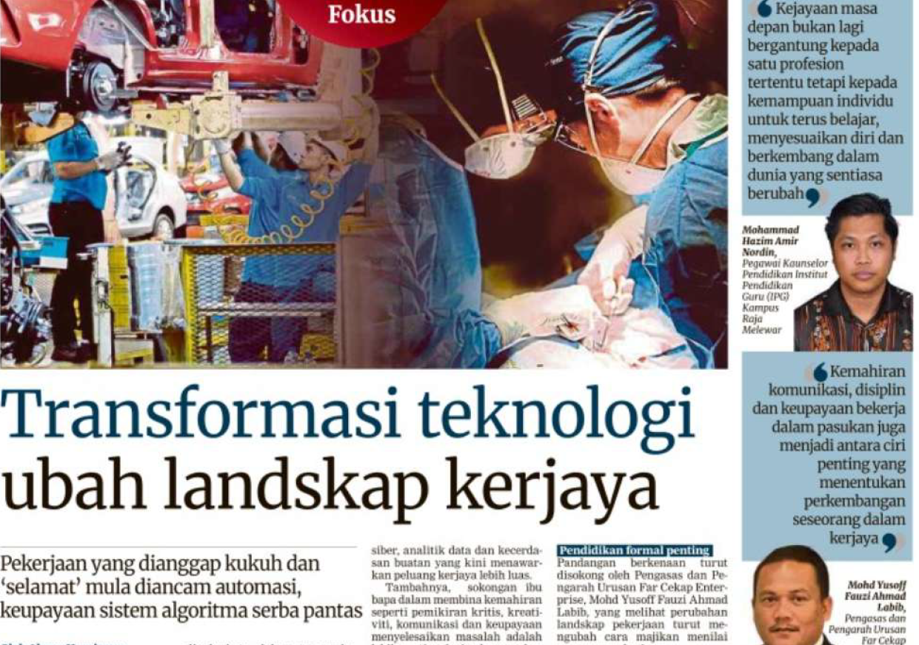
BERITA HARIAN
10 OGOS 2026
BH|TRANSFORMASI TEKNOLOGI UBAH LANDSKAP KERJAYA|MS 20

Slide 6
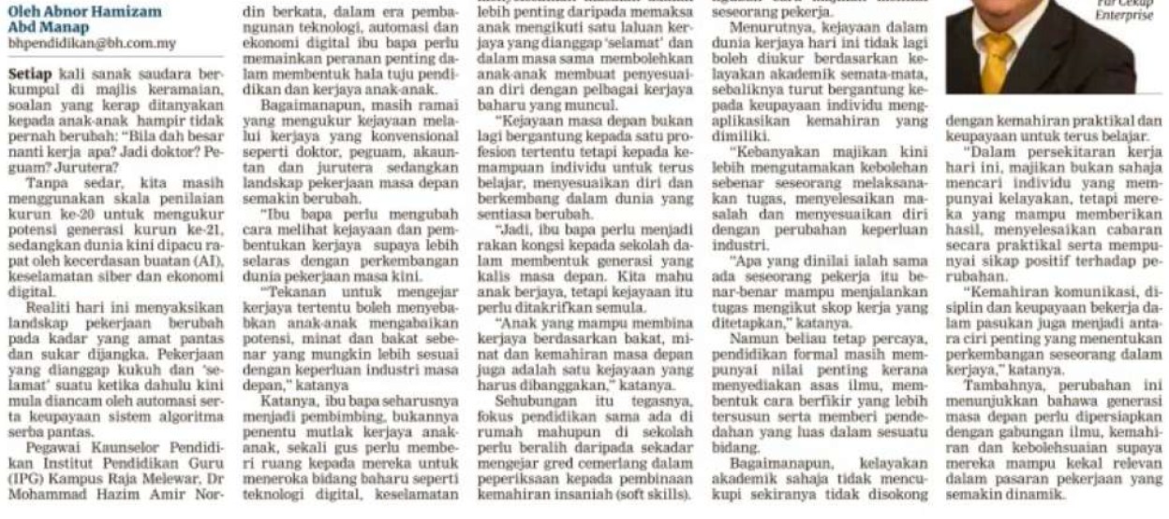
BERITA HARIAN
10 OGOS 2026
BH|TRANSFORMASI TEKNOLOGI UBAH LANDSKAP KERJAYA|MS 20 (SAMBUNGAN)

Slide 7
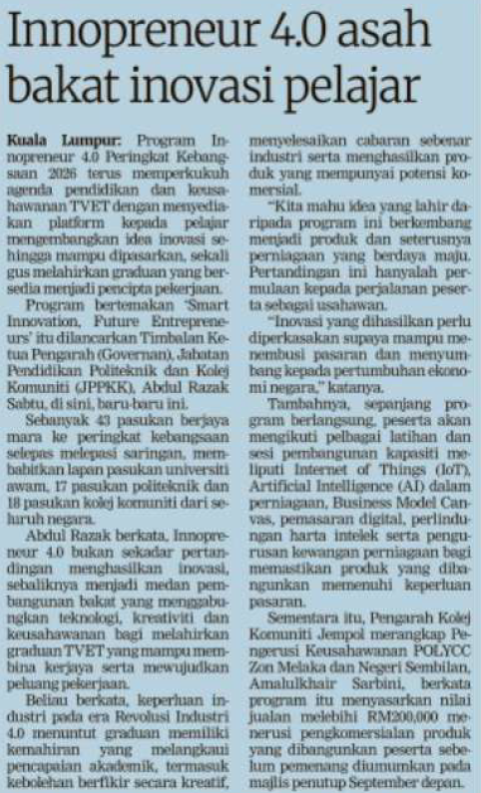
BERITA HARIAN
10 OGOS 2026
BH|INNOPRENEUR 4.0 ASAH BAKAT INOVASI PELAJAR|MS 23

Slide 8
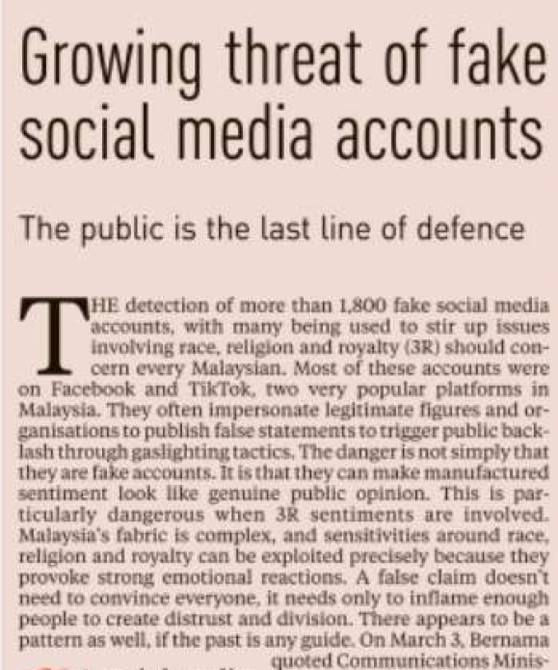
NEW STRAITS TIMES
11 AUGUST 2026
NST|GROWING THREAT OF FAKE SOCAL MEDIA ACCOUNTS| MS 2

Slide 9
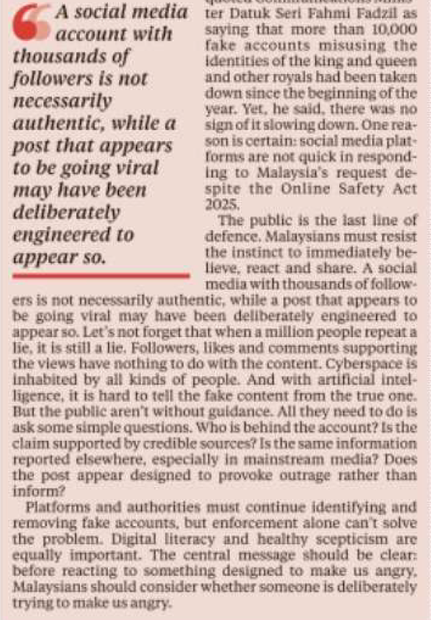
NEW STRAITS TIMES
11 AUGUST 2026
NST|GROWING THREAT OF FAKE SOCAL MEDIA ACCOUNTS| MS 2 (CONTINUED)

Slide 10
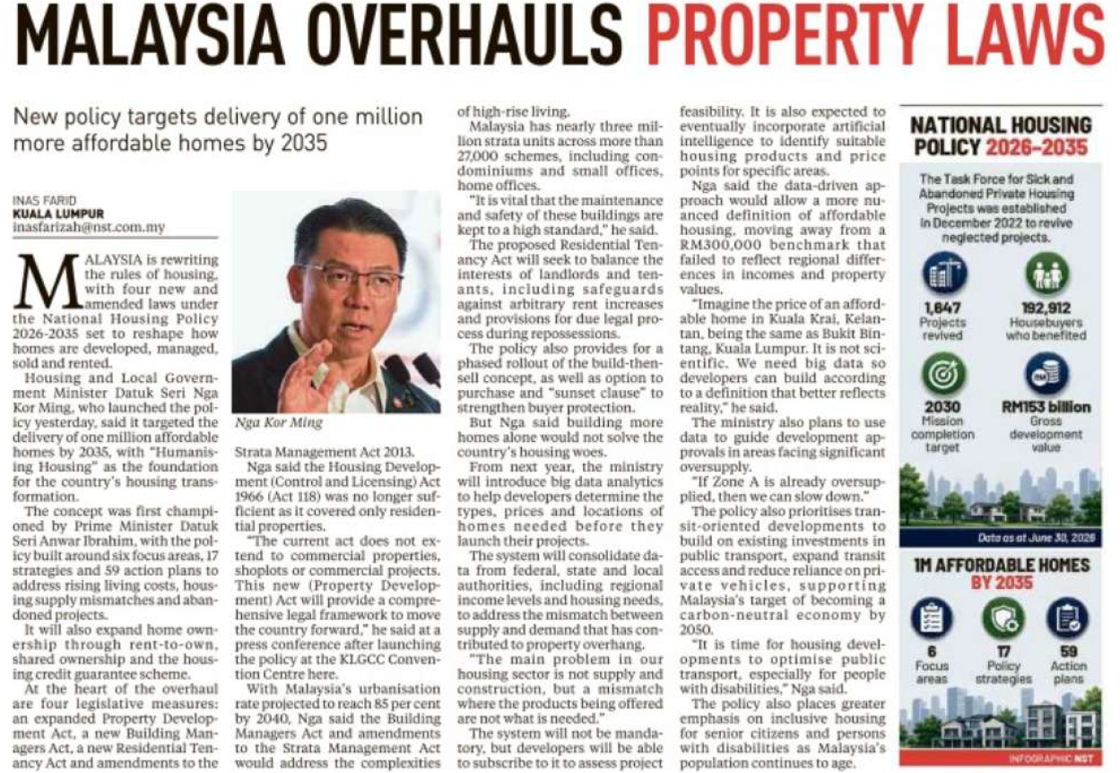
NEW STRAITS TIMES
11 AUGUST 2026
NST|MALAYSIA OVERHAULS PROPERTY LAWS|MS 5

Slide 11
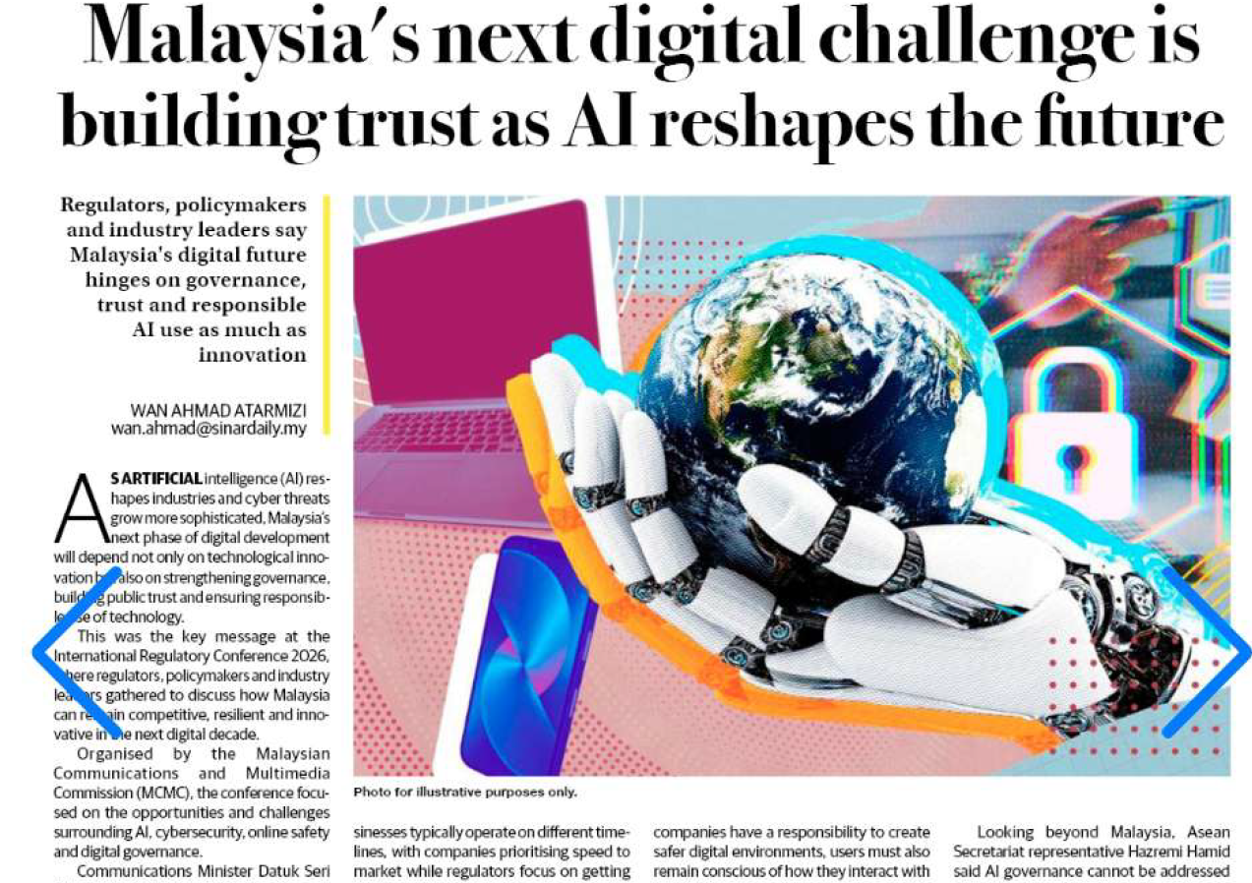
SINAR HARIAN
12 OGOS 2026
SH|MALAYSIA’S NEXT DIGITAL CHALLENGE IS BUILDING TRUST AS AI RESHAPES THE FUTURE|MS 16

Slide 12
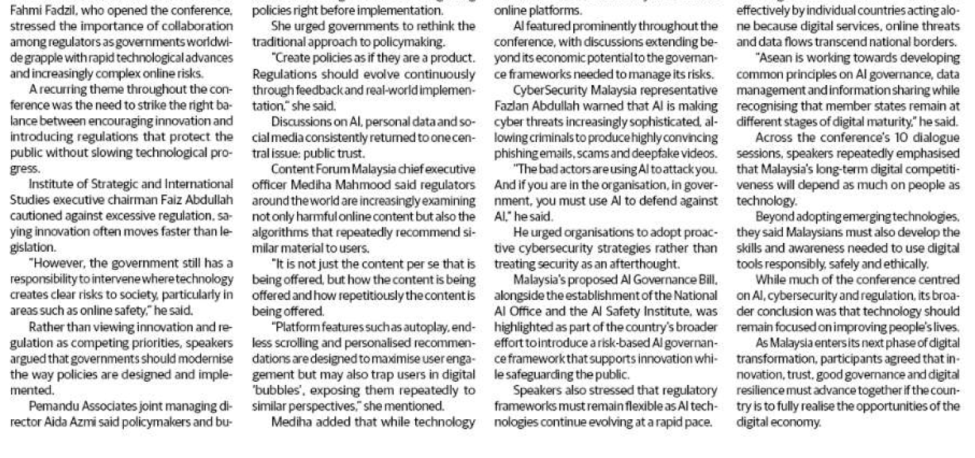
SINAR HARIAN
12 OGOS 2026
SH| MALAYSIA’S NEXT DIGITAL CHALLENGE IS BUILDING TRUST AS AI RESHAPES THE FUTURE | MS 16 (CONTINUED)

Slide 13
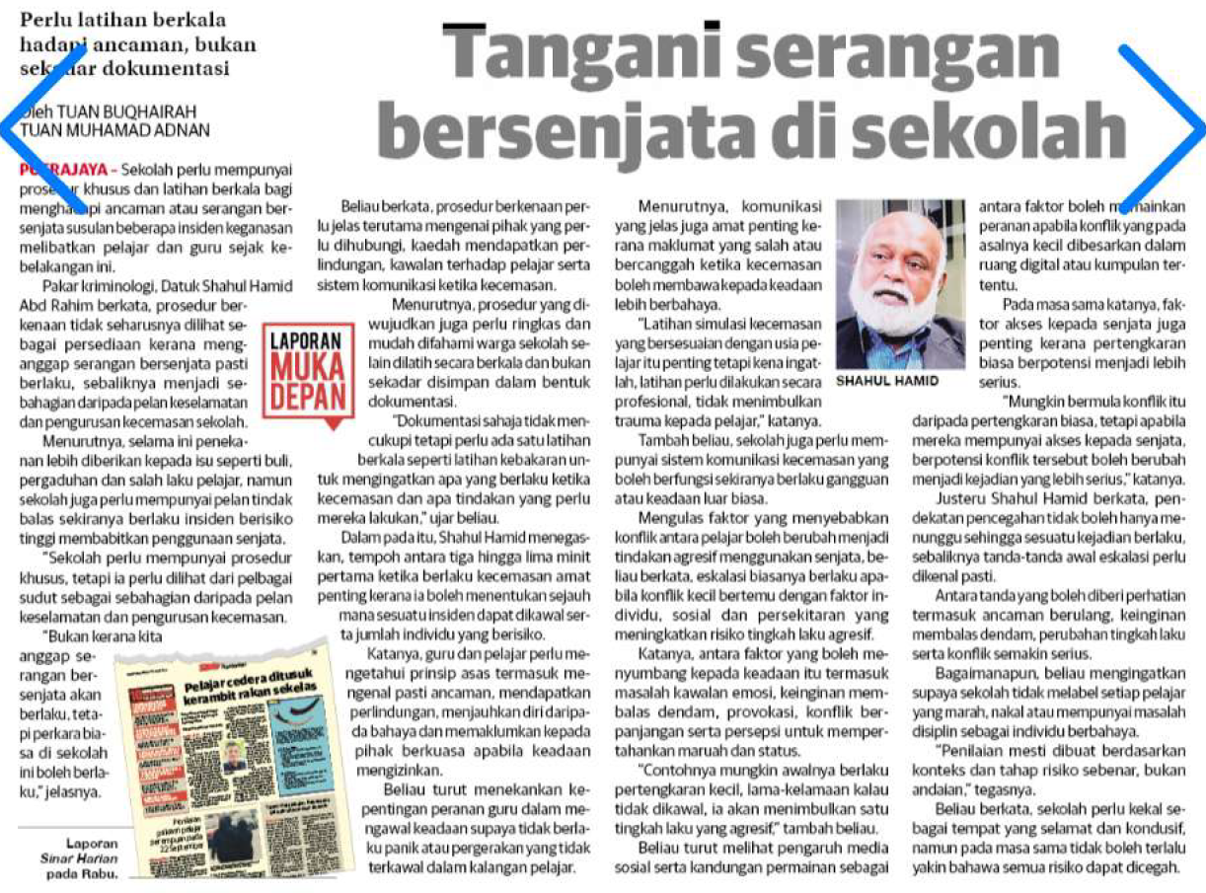
SINAR HARIAN
13 OGOS 2026
SH|TANGANI SERANGAN BERSENJATA DI SEKOLAH|MS 6

Slide 14
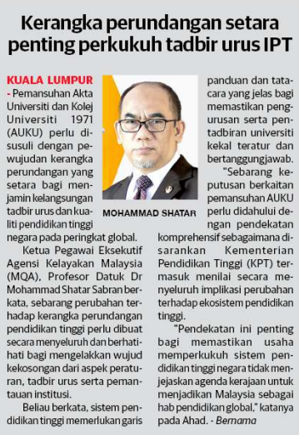
SINAR HARIAN
17 OGOS 2026
SH|KERANGKA PERUNDANGAN SETARA PERKUKUH TADBIR URUS IPT|MS 9

Slide 15
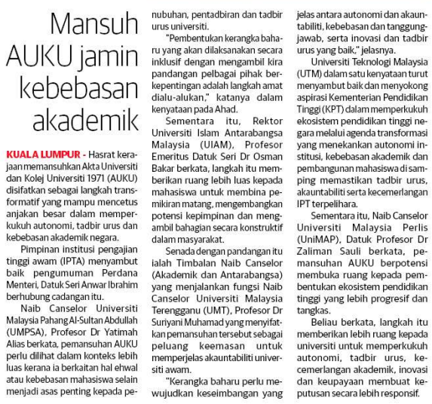
SINAR HARIAN
17 OGOS 2026
SH|MANSUH AUKU JAMIN KEBEBASAN AKADEMIK| MS 9

Slide 16
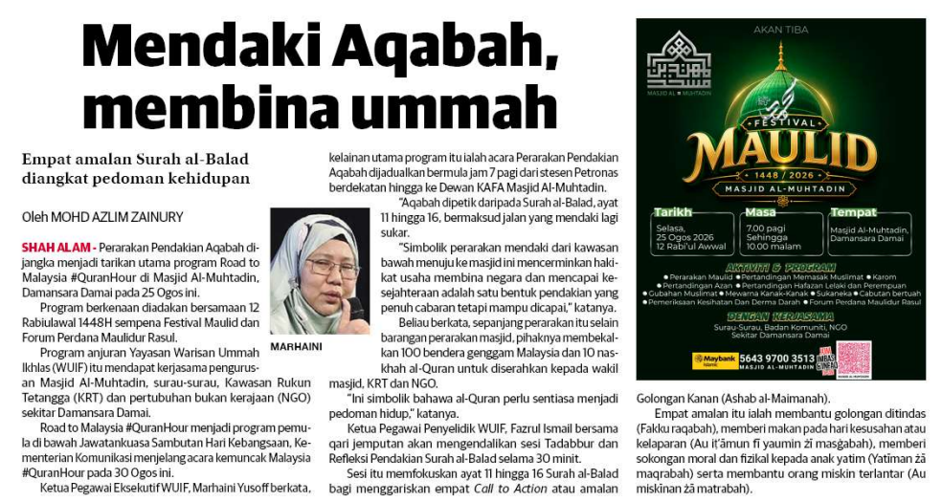
SINAR HARIAN
17 OGOS 2026
SH|MENDAKI AQABAH, MEMBINA UMMAH| MS 14

Slide 17
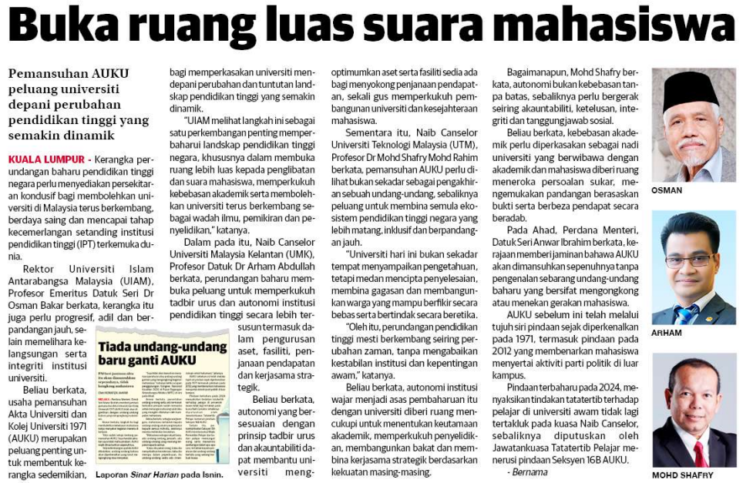
SINAR HARIAN
17 OGOS 2026
SH|BUKA RUANG LUAS SUARA MAHASISWA| MS 6

Slide 18
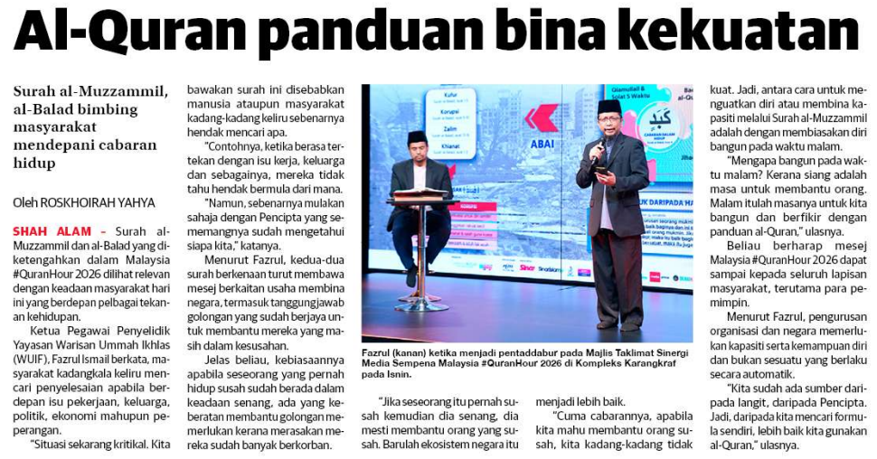
SINAR HARIAN
17 OGOS 2026
SH|AL-QURAN PANDUAN BINA KEKUATAN| MS 19

Slide 19
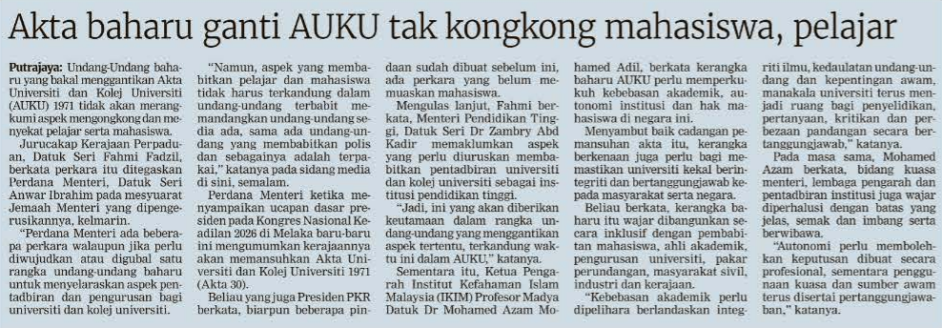
BERITA HARIAN
20 OGOS 2026
BH|AKTA BAHARU GANTI AUKU TAK KONGKONG MAHASISWA, PELAJAR| MS 8

Slide 20
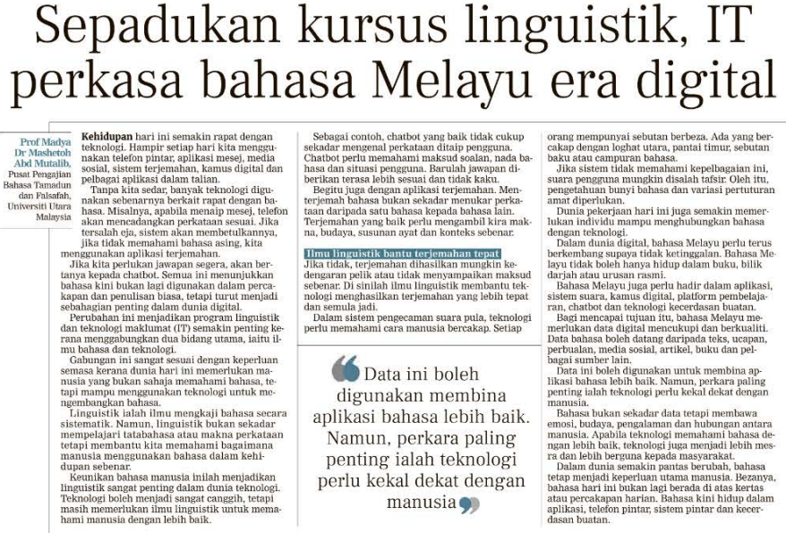
BERITA HARIAN
20 OGOS 2026
BH|SEPADUKAN KURSUS LINGUISTIK, IT PERKASA BAHASA MELAYU ERA DIGITAL| MS 8

Slide 21
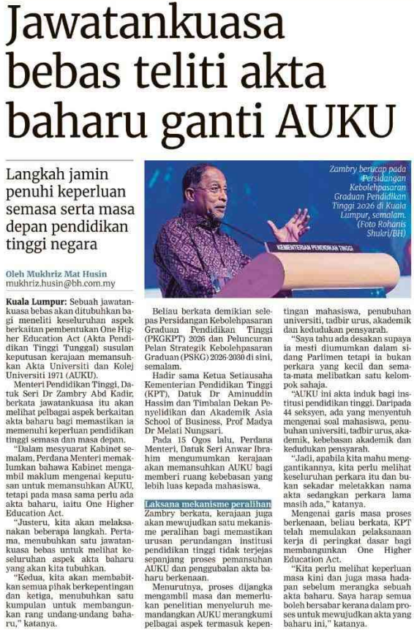
BERITA HARIAN
21 OGOS 2026
BH|JAWATANKUASA BEBAS TELITI AKTA BAHARU GANTI AUKU| MS 4

Slide 22
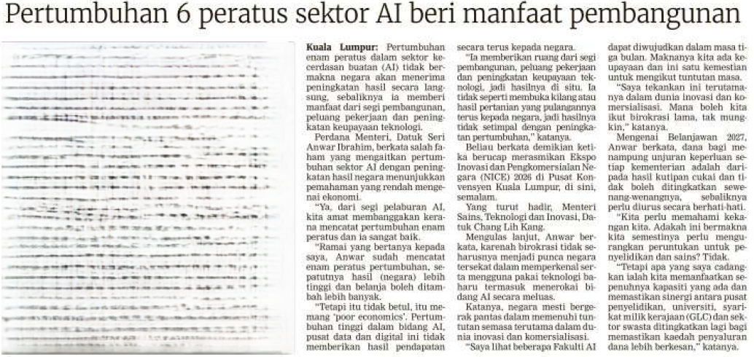
BERITA HARIAN
28 OGOS 2026
BH|PERTUMBUHAN 6 PERATUS SEKTOR AI BERI MANFAAT PEMBANGUNAN| MS 3

